Slide 1
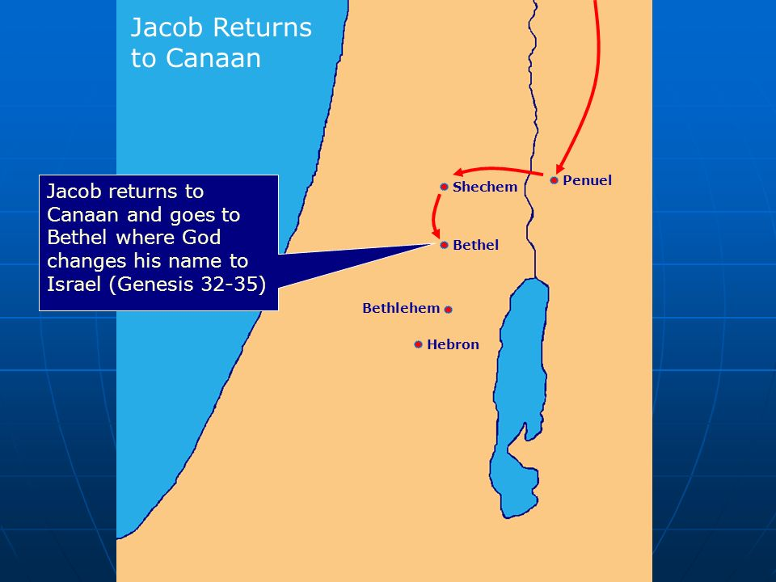
AdSS18- Joseph and his brothers
Background: Jacob and family moved from Shechem to Bethel and finally settled in Hebron (Gen 35:27).
Joseph (Gen 37:1-14)

Slide 2
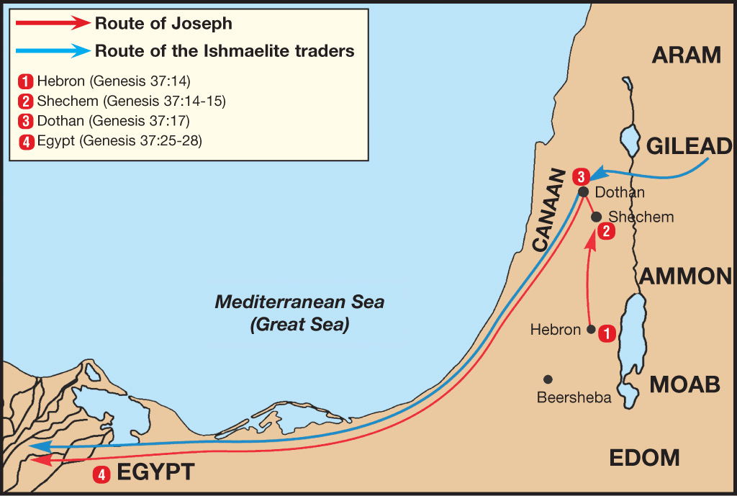
From their home in the Valley of Hebron, Shechem was about 50 miles, and Dothan was another 15 miles north. (65 miles= 105 km. Approx. the distance from Tuas to Changi and back to Tuas.)
Source: https://mlgahbuenlkv.i.optimole.com/4dIftL4-bWFsouR7/w:auto/h:auto/q:90/https://biblestudydaily.org/wp-content/uploads/2021/01/Route-of-Joseph-Gen-37.png

Slide 3
(3) Video: 1:14:00-1:16:57
(Viewers are cautioned on the inaccurate parts of the video)
Source: Abraham, Sarah, Isaac, Jacob, Joseph (movie)
(4) Comments:
Favouritism
Jealousy and Hatred
Violence
Isaac favoured Esau, Rebekah favoured Jacob.
Jacob favoured Rachel and not Leah.
Jacob favoured Joseph among the sons.

Slide 4
(5) The brothers threw Joseph into a pit. (Gen 37:15-36)
(6) Video: 1:16:57- 1:20:09
(Viewers are cautioned on the inaccurate parts of the video)
Source: Abraham, Sarah, Isaac, Jacob, Joseph (movie)

Slide 5
(7) Comments:
Why did the brothers want to kill Joseph?
Ans: The brothers were jealous of Joseph because Joseph was Jacob’s favourite son. The brothers also hated Joseph who told them of his dreams that his brothers and parents would one day bow down to honour Joseph.
[Self reflection- Were we the victims of favouritism or were we the favoured?
Do we practice favouritism in the family?
Do we practice favouritism at the workplace?
When you were young, were you jealous and hateful of your sibling who was
the favourite?
Were you jealous and hateful of your colleague who was the
favourite?
Favouritism leads to jealousy and hatred.]

Slide 6
(b) Why did the brothers not kill Joseph?
Ans: The brothers were persuaded by Reuben not to kill their own brother, Joseph, but to just throw Joseph into a pit. (Gen 37:22)
(c) The brothers sold Joseph as a slave to the Ishmaelites. (Gen 37:28)
(d) The brothers went back to Jacob to tell him that Joseph had been devoured by a wild animal by showing Joseph’s bloodied coat. (Gen 37:32)
(e) Jacob was very sad and refused to be comforted. (Gen 37:35)
[Self-reflection: No parent could be comforted if their child met with a fatality.]

Slide 7
Joseph
Joseph was sold as a slave to Egypt.
By the providence of God, Joseph became prime minister in Egypt.
Jacob and family was received in Egypt, saved from famine in Canaan.

Slide 8
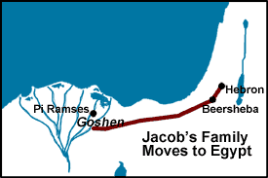
AdSS23- Jacob and family moved to Egypt
Israel
Mediterranean Sea
Egypt

Slide 9
Background: Joseph’s brothers went back to Canaan and told Jacob that Joseph was still alive. Jacob and family, totalling 70 members, moved to Egypt to meet Joseph.
Joseph went to Goshen to meet his father Jacob. (Gen 46:29-34)
Jacob met Pharoah. (Gen 47:7-9)
Jacob said unto Pharoah,
“The days of the years of my pilgrimage are an hundred and thirty years: few and evil have the days of the years of my life been…” (Gen 47:9)

Slide 10
(5) Jacob’s difficult life
Reunited with Joseph in Egypt
Fled from Esau to Haran
Tricked into working 14+ years for Laban
Contended with 4 wives competing for Jacob’s attention
Fearful of the reunion with Esau
Dinah was assaulted
Son’s revenge and fear of retaliation
Distress at Joseph’s ‘death’
Famine in Canaan
Fear of losing Benjamin

Slide 11
(6) Spiritual Lessons:
As Christians, we expect God’s blessing in our life. And God does bless us. Yet, Jacob as a spiritual father of the faith went through such a difficult life.
We should be contented with what we have.
Happy with our home.
Happy with our work.
Happy with our salary.
Despite the difficulties, Jacob remained faithful to God. So should we.
Steer away from sin.
Do things which please God.
Seeking God’s will and direction for our lives.
Close walk with God in prayer and reading of the Word.

Slide 12
Discussion:
In what way do you see God working in your life despite the difficulties?

