Slide 1
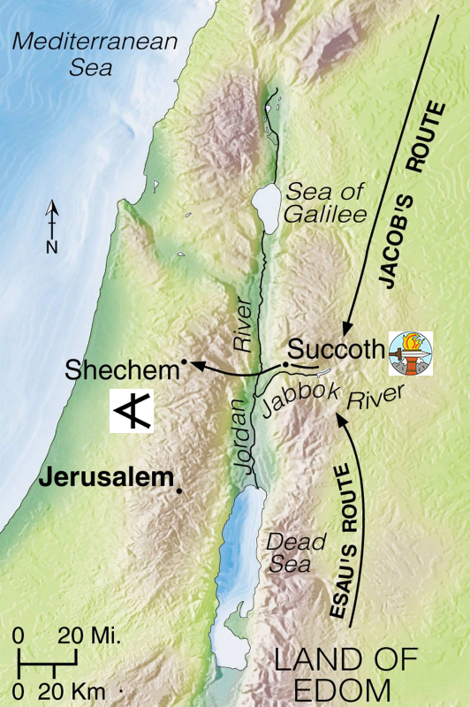
AdSS17- Tragedy and Revenge
Background: After reconciling with Esau, Jacob and family moved to Schechem.
Tragedy struck Dinah, Jacob’s daughter. (Gen 34:1-12)
Video: 1:06:07 – 1:07:15
(Viewers are cautioned on the inaccurate parts of the video)
Source: Abraham, Sarah, Isaac, Jacob, Joseph
Source: http://godswarplan.com/attack-on-shechem-rape-of-dinah-simeon-and-levi-revenge-genesis-34

Slide 2
(3) Spiritual Lesson:
Date rape:
CNA, 23 Apr 2019. SINGAPORE: Three men who claimed trial to various charges of sexual assault of an 18-year-old teenager at a birthday party on Jan 26, 2014 were found guilty.
The court heard that the victim was plied with alcoholic drinks by another man until she collapsed to the floor.
While unconscious and vulnerable in the hotel room, the woman was sexually assaulted by five men. Two of the men were sentenced to between 11 and 13 years' jail and six to eight strokes of the cane. The other three were awaiting sentencing.
(Source: https://www.channelnewsasia.com/singapore/three-men-gang-rape-unconscious-teenager-duxton-hotel-guilty-888066)

Slide 3
Straits Times. PUBLISHED
NOV 17, 2021.
SINGAPORE - A man who was given 28 years' jail and 24 strokes of the cane for raping a 13-year-old girl. He admitted that he force-fed vodka to the victim and brutally raped and sexually assaulted her over a harrowing two hours at a secluded part of Kallang Riverside Park on the night of Oct 24, 2017.
The victim was acquainted with him through one of her friends and called him "uncle".
(Source: https://www.straitstimes.com/singapore/courts-crime/man-who-raped-13-year-old-fails-in-appeal-for-lighter-sentence)

Slide 4
AWARE –
“Most rapes are not committed by a stranger, but by people who know their victims. Many victims have met or gone out with their assailant previously and are supposedly their friends. This is called “acquaintance” or “date” rape.”
(Source: https://www.aware.org.sg/information/rape/date-rape/)
(b) Please take care going out with friends. Safety tips: AWARE website.
(c) Schechem desired to marry Dinah as an object to fulfil his lust. He does not love Dinah as love will not give rise to defilement of Dinah, a crime of violence.

Slide 5
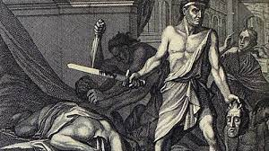
(4) Jacob’s son’s revenge. (Gen 34:13-31)
(5) Video: 1:07:15 – 1:10:06
(Viewers are cautioned on the inaccurate parts of the video)
Source: Abraham, Sarah, Isaac, Jacob, Joseph
Source: http://godswarplan.com/attack-on-shechem-rape-of-dinah-simeon-and-levi-revenge-genesis-34

Slide 6
(5) Comment:
LUST
DEFILE-MENT
HATRED
REVENGE
KILLING & LOOTING
RETALIATION
Gen 34:2
Gen 34: 7
Gen 34:30, Gen 35:5
Gen 34:2
Gen 34: 13
Gen 34:25-29

Slide 7

(6) Spiritual Lesson:
Don’t take revenge.
Revenge will give rise to retaliation and continued violence.
Innocent people may be harmed.
Unreasonable bosses, colleagues, clients, friends - don’t take revenge.
Source: https://twitter.com/ValenClaire3/status/1419599784260763651

Slide 8

I seek revenge against A
A offended me
I hate A
1 John 3:15: Whosoever hateth his brother is a murderer: and ye know that no murderer hath eternal life abiding in him.
Matthew 5:44: But I say unto you, love your enemies, bless them that curse you, do good to them that hate you and pray for them which despitefully use you, and persecute you.

Slide 9
Hate / dislike
Love
(A) Prayer:
Self-restraint
Forgiveness
Not to be judgmental
Remove negativism towards the person you hate/dislike
(B) Change in attitude
(C) Change in conduct

Slide 10
Straits Times . PUBLISHED NOV 11, 2019.
SINGAPORE - More than 200 pieces of luggage belonging to passengers of Singapore Airlines (SIA) and SilkAir ended up at the wrong destinations after an airport baggage handler swopped the tags because he was unhappy with his duties.
The baggage handler was sentenced to 20 days' jail for mischief.
(Source: https://www.straitstimes.com/singapore/courts-crime/20-days-jail-for-ex-baggage-handler-who-swapped-the-tags-of-286-pieces-of)

Slide 11
Group sharing in groups of 2 to 4
(1) Share practical ways to love persons you hate/dislike.

