Slide 1
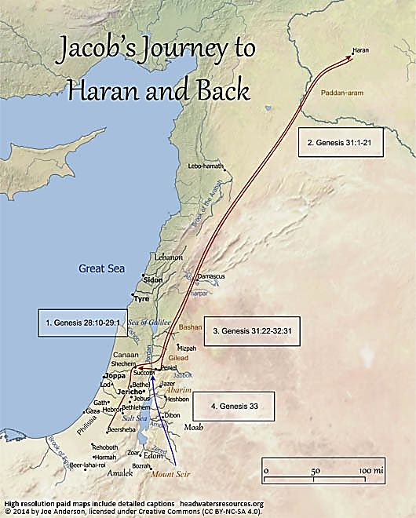
AdSS16-Jacob reconciled with Esau
Map of Jacob’s journey from Haran back to Canaan
Background: Jacob left Laban for Canaan.
(2) At Mahanaim (near Peniel), Jacob sent a message to Esau. (Gen 32:3-5)
(3) Esau travelled from Mt Seir to meet Jacob (Blue arrow)

Slide 2
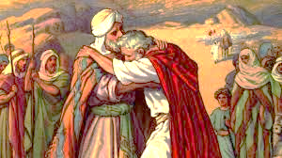
(4) Comment on Jacob’s message to Esau
Jacob remembered Esau’s threat to kill him because of his deceit.
Jacob wanted to reconcile with Esau.
Jacob’s message was couched in very humble terms, calling himself “Your servant Jacob.” He addressed Esau as “my Lord”. (Gen 32:4)
In the message, Jacob would bring generous gifts for Esau.(Gen 32:5)
Source: https://netivyah.org/parashat-vayishlach/

Slide 3
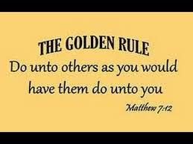
(5) Spiritual Lesson on Jacob’s message to Esau:
If you wish others to have you in high regard, you must have high regard for others.
Kind to offer gifts to others.
Matthew 7:12.
Source: https://pendernews.org/tag/matthew-712/

Slide 4
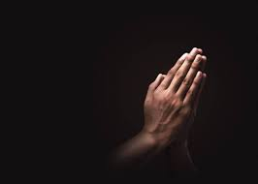
(6) Esau was coming with 400 men to meet Jacob. (Gen 32:6)
(7) Jacob was fearful and distressed and prayed to God. (Gen 32:7-13)
Source: https://www.istockphoto.com/hk/search/2/image?phrase=prayer

Slide 5
(8) Jacob selected gifts to reconcile with Esau. (Gen 32:14-15)
(9) Jacob sent the gifts ahead. He taught the servants to speak in humility to Esau to win Esau’s reconciliation. (Gen 32:17-21)
(10) Fearful that Esau was coming to kill him and his family, he sent his family away. (Gen 32:22-23)
(11) Jacob wrestled with God. (Gen 32:24-30)

Slide 6
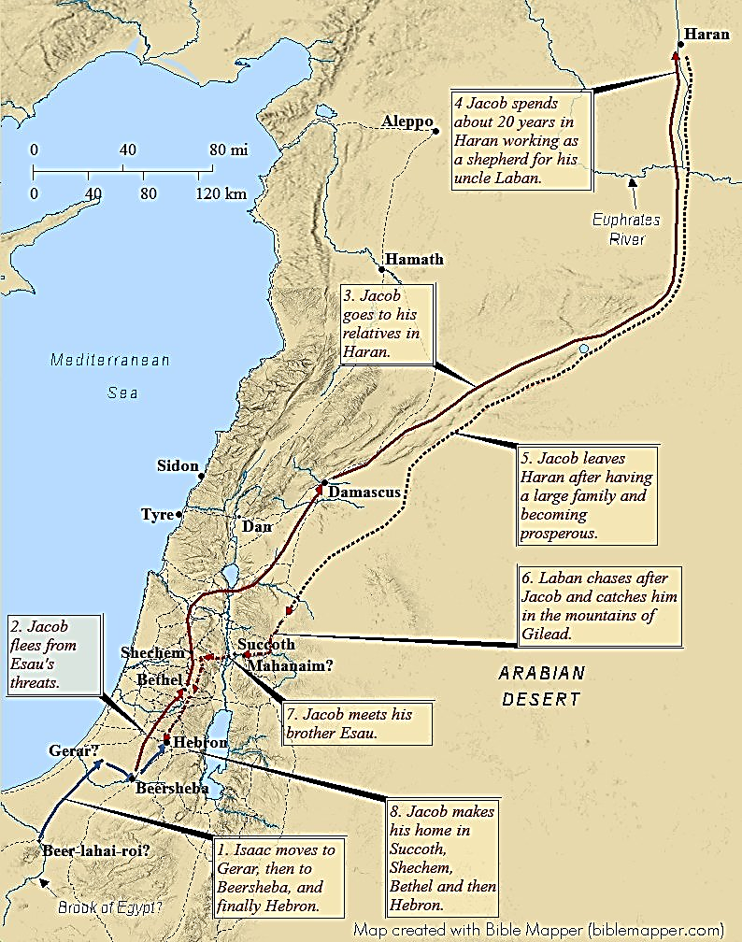
Map of Jacob’s journey

Slide 7
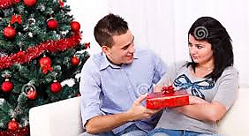
(12) Video: 1:13:55-1:20:00
(Viewers are cautioned on the inaccurate parts of the video)
(Source: The Bible Stories, Abraham
By Lube Production)
(13) Spiritual Lesson:
When we are fearful and distressed, do we pray?
Source: https://www.dreamstime.com/royalty-free-stock-photo-christmas-reconciliation-image29150405

Slide 8
(c) It is natural to have fear:
Rational fear
Irrational and excessive fear
(d) When fearful, read the Psalms. David was full of fear: Psalm 143. Psalm of deliverance: Psalm 91.
(e) How do we reconcile or show appreciation to another?
Address the other person with high regard and respect.
Giving gifts.
(f) God appeared to Jacob in his distress. Has God spoken to us in our distress?

Slide 9
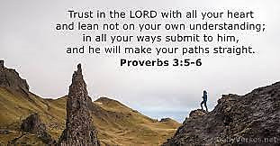
(14) Jacob met Esau. (Gen 33:1-16)
Jacob bowed down to Esau. (Gen 33:3)
Esau ran and embraced Jacob. (Gen 33:4)
There was no animosity on Esau’s part.
Esau never broached the subject of Jacob’s deception.
Jacob was fearful over an event that did not take place by the grace of God.
Proverbs 3:5,6.
Video is inaccurate.
Source: https://dailyverses.net/proverbs/3/5-6

Slide 10
Jacob referred to himself as Esau’s servant. (Gen 33:5)
Jacob’s female servants and children bowed down to Esau. (Gen 33:6)
All these flocks and herds are gifts to Esau. Jacob referred to Esau as his lord. (Gen 33:8)
Jacob insisted that Esau accepts the gifts. He was so relieved that Esau had received him (Jacob) favourably. (Gen 33:10)
When Jacob and Esau parted, Jacob paid deference to Esau by letting him go first. (Gen 33:14)
Esau went back to Mt Seir. Jacob went on to Sukkoth and Shechem.

Slide 11
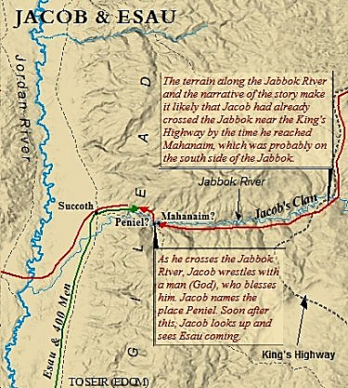
Map of Jacob and Esau meeting at Peniel. (Gen 33:1)
Source: https://www.israel-a-history-of.com/jacob-and-esau.html#gallery[pageGallery]/5/

Slide 12
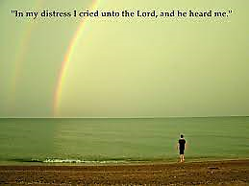
(15) Video: 1:20:20-1:24:14
(Viewers are cautioned on the inaccurate parts of the video)
(Source: The Bible Stories, Abraham
By Lube Production)
(16) Spiritual Lesson:
In our distress, crying out to God.
Reconciling and paying respects to others.
Personal sharing.
Psalm 120:1
Source: https://bibletreasuresfortoday.com/tag/crying-out-to-god/

Slide 13
Discussion:
(1) Share an event when you cried out to God in distress and God delivered you. Has that event changed your relationship with God? How?

