Slide 1
AdSS15- Jacob’s share in Laban’s flock
Background: Jacob had 12 sons and a daughter.
Jacob wanted to leave Laban. (Gen 30:25)
Laban persuaded Jacob to stay as he saw God had blessed him (Laban) because of Jacob.(Gen 30.27)

Slide 2

(4) Jacob was persuaded by Laban to stay. They agreed on a division of the flock for Jacob and Laban. (Gen 30:32-34)
(5) Jacob’s spotted sheep. (Gen 30:37-43)
Source: https://www.youtube.com/watch?v=HvbYYQ8SsnM

Slide 3
(6) Video: 59:45-1:03:06
(Viewers are cautioned on the inaccurate parts of the video)
(Source: The Bible Stories, Abraham
By Lube Production)
(7) Bible commentators are of the view that God told Jacob the strategy to divide the flock.
(8) God was with Jacob and prospered Jacob. Jacob had already served Laban for 14 years and was tricked into marrying Leah. God saw the wickedness of Laban and was not with Laban.

Slide 4
(9) Comments
Don’t be a Laban. He took advantage of others and benefitted through trickery and deceit:
  Tricked Jacob into marrying Leah.
  Jacob had to work 14 years to marry Rachel (and Leah).
  Did not allow Jacob to leave after 14 years but to continue working for him.
(b) Jacob learnt his lesson not to take advantage and deceive others:
  Took advantage of Esau for his birth rights.
  Deceived Isaac, his father, into believing that he was Esau.
  Through deception, took Esau’s blessing.

Slide 5

(10) Spiritual Lesson:
Jacob learnt his lesson. Have we learnt our lesson?
(b) Galatians 6:7 -
Source: https://iliveforjesus.in/reap-what-you-sow/

Slide 6
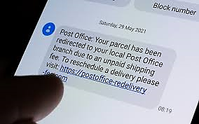
(c) Fake news
(d) Scammers – OCBC https://www.straitstimes.com/singapore/courts-crime/ocbc-bank-customer-lost-120k-in-fake-text-message-scam-another-had-250k-stolen
(e) Scammers use fear tactics.
Source: https://www.telegraph.co.uk/news/2021/12/23/tenfold-spike-christmas-delivery-scams-preying-publics-fear/

Slide 7

(f) God says “Do not fear for I am with you.”
(g) When fearful, don’t click anything.
(h) Pause to pray.
(i) Ask Christian friends for counsel.
Source: https://www.facebook.com/bibleversesimages/posts/so-do-not-fear-for-i-am-with-you-do-not-be-dismayed-for-i-am-your-god-i-will-str/912299282452415/

Slide 8
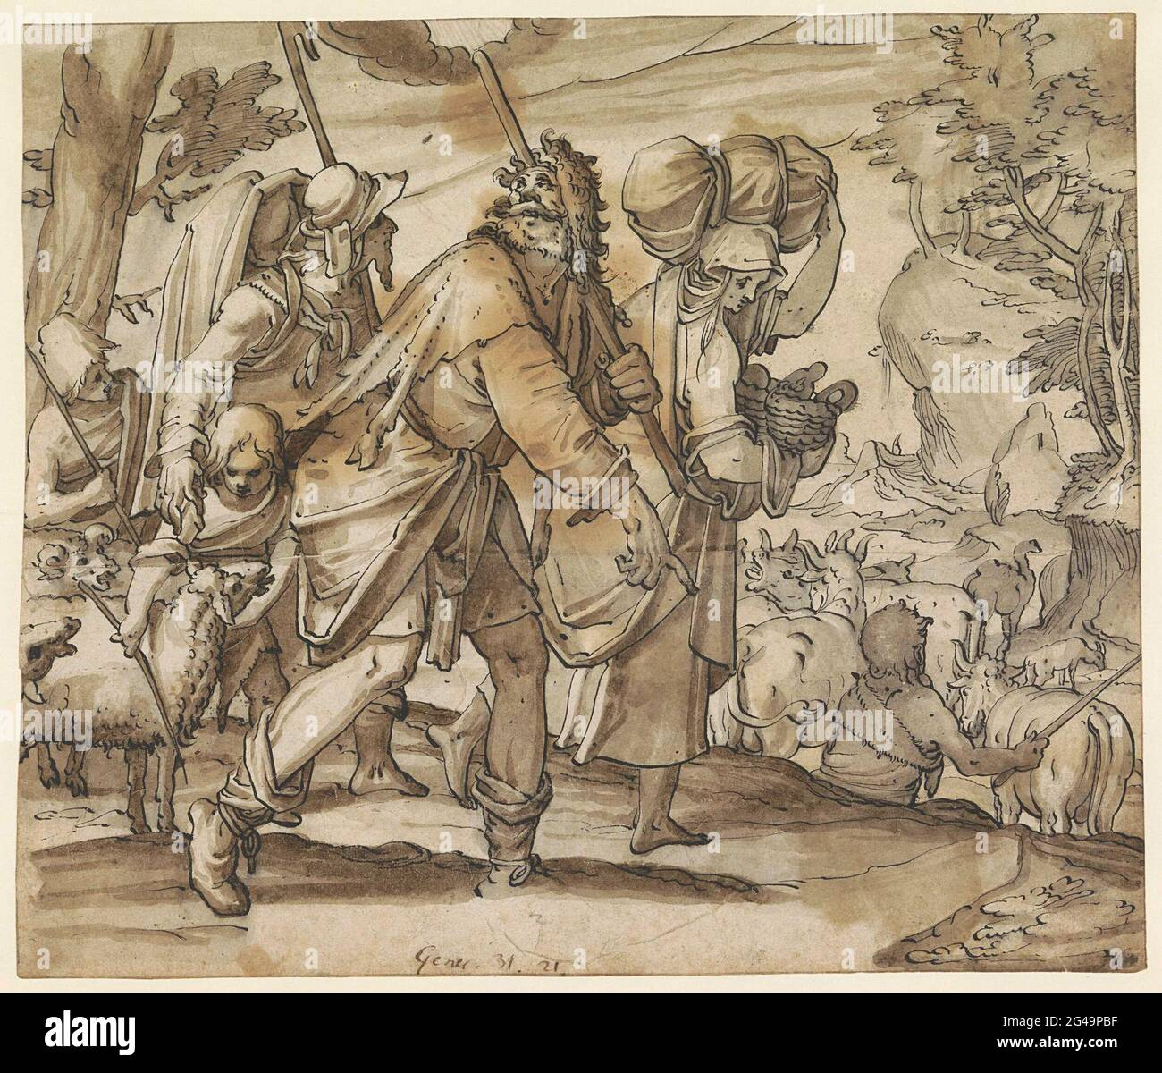
(10) God told Jacob to go back to Canaan. (Gen 31:3-6)
(11) God had not allowed Laban to harm him. (Gen 31:7-9)
(12) Jacob fled from Laban and Laban pursued Jacob. (Gen 31:17-37)
Source: https://www.alamy.com/jacob-fled-laban-in-the-land-kanaan-possible-design-for-a-glass-window-image432932963.html

Slide 9
(13) Jacob complained of being badly treated by Laban. (Gen 31:38-42)
(14) Laban made peace with Jacob and left. (Gen 31:51-55)
(13) Video: 1:09:25-1:13:00
(Viewers are cautioned on the inaccurate parts of the video)
(Source: The Bible Stories, Abraham
By Lube Production)

Slide 10

(12) Spiritual Lesson:
God protects the innocent against the evil one.
If subject to abusive treatment , God protects and provides for those who are oppressed.
(c) Pray for God’s will and provision.
Source: https://nancyaruegg.com/tag/gods-protection/

