Slide 1
AdSS14-Jacob and Rachel
Background: God appeared to Jacob in a dream and encouraged him. (Gen 28:12-13)
Jacob reached Haran and met Rachel and Laban. (Gen 29:10-15)

Slide 2
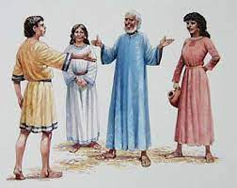
(3) Jacob was tricked into marrying both Leah and Rachel. (Gen 29:18-30)
Source: https://simlachandigarhdiocese.wordpress.com/2015/03/16/jacob-marries-leah-and-rachel/
(4) Video: 51:50-53:32
(Viewers are cautioned on the inaccurate parts of the video)
(Source: The Bible Stories, Abraham By Lube Production)

Slide 3
(5) Comments:
The wickedness of Jacob:
Jacob took advantage of Esau for the rights of firstborn.
Jacob tricked Isaac into blessing him.
Through deception, Jacob robbed Esau of his blessing.
Jacob’s just desert:
(i) Jacob was tricked by Laban:
  into marrying both daughters.
  working for Laban for 14 years for both the daughters.
Psalm 28:4:
“Give them according to their deeds, and according to the wickedness of their endeavours: give them after the work of their hands; render to them their desert.”

Slide 4
(6) Spiritual Lesson:
Justice served on Jacob.
(b) Sometimes, due to our wrong-doings, God visits us with ‘just desert’ (ie. the punishment that one deserves.)
(c) We must learn:
  Not to take advantage or do harm to others, lest God visits us with ‘just desert.’
  If others take advantage or harm us, we must not take revenge. God will deal justly with them.
(d) Do not take revenge: “Vengeance is mine; I will repay.” (Rom 12:19)

Slide 5
(7) Contest for Jacob’s love (Gen 29:31- 30:25)
(8) Video 55:14 – 59:14
(Viewers are cautioned on the inaccurate parts of the video)
(Source: The Bible Stories, Abraham
By Lube Production)

Slide 6
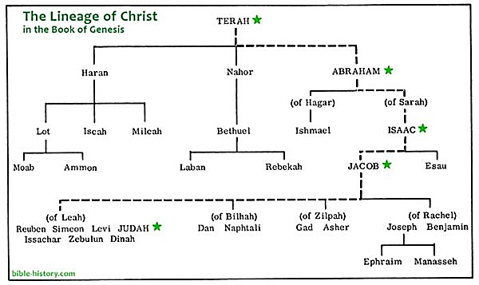
(9) The contest to give birth:
Source: https://www.myolivetree.com/the-family-tree-of-the-bible-from-abraham-to-jesus-to-you/

Slide 7
(10) Comments:
(a) Jacob’s 4 wives: + There was jealousy from Rachel. (Gen 30:1)
+ Jacob’s anger (Gen 30:2)
+ Rachel’s rivalry with Leah to have children (Gen 30:8)
+ Leah’s counter-measure against Rachel by giving Zilpah to
Jacob (Gen 30:9)
+ Trading for Jacob’s company (Gen 30:15)

Slide 8
(11) Spiritual Lesson:
Having more than 1 life partner will bring about conflicts and strife in the family.
We observe: Sarah and Hagar
Jacob’s 4 wives
(b) There are many cases of broken family due to marital infidelity even among believers.

Slide 9
(12) Straits Times. PUBLISHED APR 19, 2019 –
Singaporeans are cheating with their colleagues; counsellors see more extramarital affairs.
SINGAPORE - He started exercising and giving himself a makeover. His sudden transformation raised suspicions with his wife, who later found out he was having an affair. A private investigator revealed that he was indeed cheating on her … The couple, as well as the third party, were in their 30s and early 40s.
Counsellors and lawyers The Straits Times spoke to … said infidelity cases here tend to involve couples in their 30s and 40s. The median ages for male divorcees in Singapore was 43.2 years in 2017 and 39.1 years for females. They usually have older school-going children and elderly parents. With attention focused on other aspects of family life instead of the marriage, some might stray. Counselling groups say they have seen a marked increase in cases involving infidelity over the past three years.

Slide 10
(13) Tips to avoid infidelity:
Despite differences, “Love your wife” (Eph 5:25).
Do not look more than cursorily. (2 Sam 11:2)
Remember how God dealt with people who committed infidelity:
* Abraham was grief-stricken to send Hagar and Ishmael away.
* Jacob had to contend with much strife from 4 women.
* David’s 4 sons had to die because of his sin of adultery and murder.
(d) Occupy our mind with:
“Whatever things are true,
whatever things are noble,
whatever things are just,
whatever things are pure,
whatever things are lovely,
whatever things are of good report…meditate on these things.” (Phil 4:8)

Slide 11
Discussion:
Share your observation of people with more than 1 marriage partner ( girl friends and mistresses included). Is the family a happy family?
If (1) is an unhappy family, what is the cause of the unhappiness? How to remedy the situation?

