Slide 1
AdSS13-Jacob fled
Background: Jacob deceived Isaac into blessing Jacob with Esau’s blessing. Esau hated Jacob and wanted to kill him. (Gen 27:41)
Jacob fled on the basis of looking for a wife in Haran. (Gen 28:1-2)

Slide 2
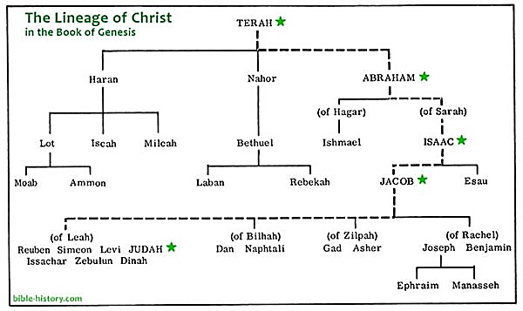
(3) Jacob went to Paddan Aram, to Laban, son of Bethuel. (Gen 28:5)
Source: https://www.myolivetree.com/the-family-tree-of-the-bible-from-abraham-to-jesus-to-you/

Slide 3
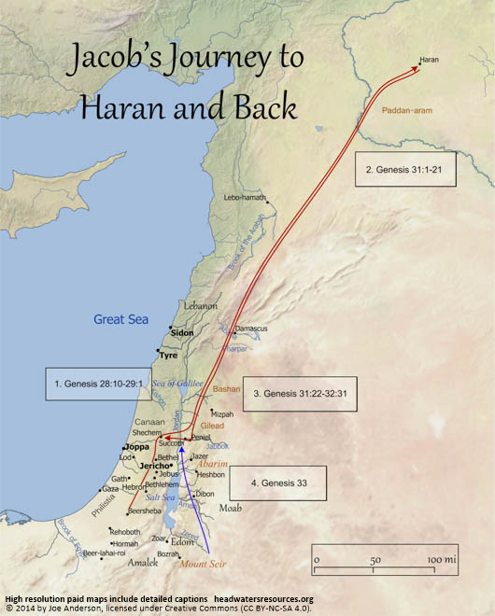
Jebus = Jerusalem
Source: https://headwatersresources.org/map-of-jacobs-journey-to-haran-and-back/

Slide 4
(4) Esau learnt of Isaac’s bidding Jacob to look for a wife among the relatives. He took an Ishmaelite wife, hoping to please his parents. (Gen 28:8-9)
(5) Spiritual Lesson:
Not to be unequally yoked. Ishmaelite woman came from the descendants of Ishmael, not chosen of God.

Slide 5
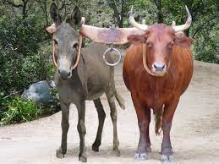
Yoke
Unequally yoked
(5) Spiritual Lesson:
(b) Take care to choose:
a right life partner
a right business partner
close friends
Source: https://gone-fishin.org/2011/09/01/being-unequally-yoked/

Slide 6
(5) Spiritual Lesson:
(c) Further, Esau already had 2 Hittite wives. God never intended persons to have more than one marriage partner. This includes extra marital affairs.
Conflicts between wives, mistresses and children
Inheritance

Slide 7
(6) Jacob’s ladder (Gen 28:11-22)
(7) Video: 24:50-28:27
(Viewers are cautioned on the inaccurate parts of the video)
(Source: The Bible Stories, Abraham
By Lube Production)
(8) Commentary
Jacob had to flee
He was fearful and all alone in an arid country
God appeared to Jacob when he was in his hour of need.
God assured him that he and his descendants would be blessed. God also assured him that He would be with him wherever he went.
Jacob was encouraged and pressed on his journey.

Slide 8

(9) Spiritual Lesson
God will encourage us in our hour of need
Troubles in our life are ordained by God so that we would seek Him. He will answer and restore us. Then, our faith in Him will grow.
Source: https://www.christianquotes.info/quotes-by-topic/quotes-about-trials/

Slide 9

(c) Recall the times when you faced the trials of life:
How did God restore you?
How did your faith grow in Him?
(d) We must remember God’s faithfulness in restoring us and have faith in Him.
Source: https://me.me/i/will-restore-to-you-joel-2-25-17001552

