Slide 1

AdSS12- Jacob’s deception
Background:
God has pre-ordained Jacob to be a leader of the Israelites. (Rom 9:13).
Isaac loved Esau. Rebekah loved Jacob. (Gen 25:28)
(2) Spiritual Lesson:
Favouritism: unfair preferential treatment
Favouritism in the family is to be avoided.
Favouritism is a sin. (James 2:9)
Source: https://www.dawn.com/news/1432705

Slide 2
Rebekah overheard Isaac
(3) Isaac instructed Esau: Gen 27:1 – 5
(4) Rebekah loved Jacob and devised a plan to deceive Isaac into blessing Jacob instead of Esau.
(5) This is a sin of favouritism and deception.
Rebekah told Jacob to deceive Isaac

Slide 3
Rebekah’s plan was carried out by Jacob
(6) The 2 colluded on a plan of deception: Gen 27:6- 18
(7) Video: 09:44-13:09
(Viewers are cautioned on the inaccurate parts of the video)
(Source: The Bible Stories, Abraham, By Lube Production)

Slide 4

(8) Spiritual Lesson:
In what ways do we practice favouritism in:
(i) our family: “prince or princess”
(ii) among friends
(iii) among colleagues: “blue-eye boy”
(iv) in school: “Teacher’s pet”
Source: https://www.herworld.com/women/career/how-handle-favouritism-work-big-girl/

Slide 5

(b) How do we act without favouritism?
Performance based on merit and fairness
Even when we praise a person based on merit, there should be words of encouragement for those who did not perform as well.
Source: https://fospath.com/how-to-praise-someone-for-their-work-100-ways-to-say-thank-you/

Slide 6
Jacob pretended to be Esau before Isaac
(9) Isaac was deceived by Jacob: Gen 27: 18-27
(10) Isaac’s blessing: Gen 27:28-29
Being deceived, Isaac blessed Jacob

Slide 7
Esau realised that his blessing had been taken dishonestly by Jacob
(11) Gen 27:30 – 40
(12) Gen 27:41
Esau hated Jacob and wanted to kill him

Slide 8
Rebekah told Jacob to flee
(13) Gen 27:42-45
(14) Video: 13:09-19:13
(Viewers are cautioned on the inaccurate parts of the video)
(Source: The Bible Stories, Abraham, By Lube Production)

Slide 9
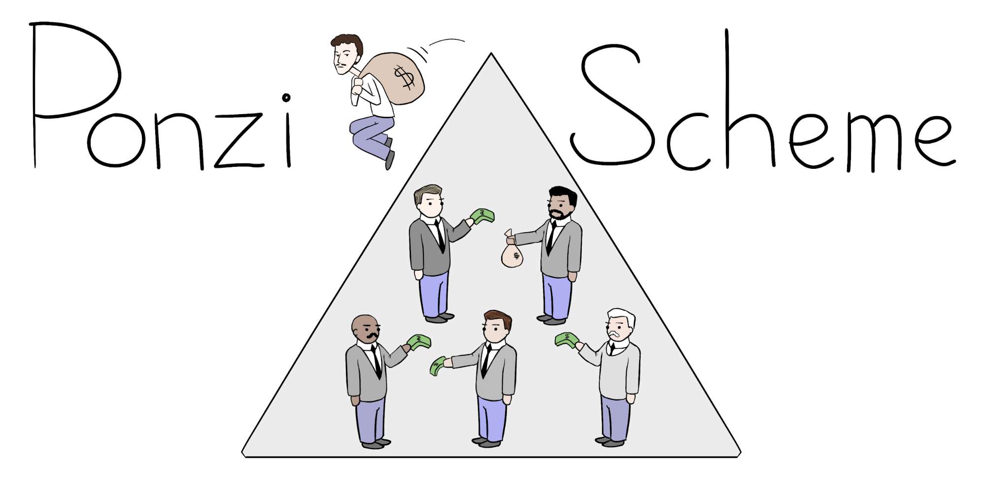
(15) Spiritual Lesson:
We learn in the narrative: favouritism > deception and lies > hatred > violence > fleeing.
Deception and hatred:
Lying is ok? Big lies and small lies? Means vs end
Ponzi scheme
Source: https://bioplasticsnews.com/2020/06/29/bioplastics-ponzi-scheme/

Slide 10
Discussion
In what ways are we like Jacob? Do we take advantage of others? What must we do to show a good testimony as a Christian? Share your observation in your life.

