Slide 1
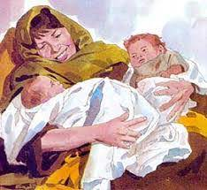
AdSS11- Jacob & Esau
Abraham died at the age of 175 years old.
Isaac was 60 years old when Rebekah gave birth to Esau and Jacob.
The LORD said that two nations were in Rebekah’s womb. The 2 peoples within her womb would be separated. The older would serve the younger. (Gen 25:23)
Source: https://jaymack.net/gm-two-nations-one-womb-25-19-26/

Slide 2

(4) Rom 9:13:
“As it is written, Jacob have I loved, but Esau have I hated.”
(5) Rom 9:13 demonstrates the doctrine of election. Jacob, not Esau, was chosen by God as a head of the spiritual lineage of God’s people.
(6) God’s election does not depend on the spirituality, intellect or might of a person.
(7) In the same way, we have been chosen (saved) by God before the beginning of the world to be God’s people. (Eph 1:4)
Source:https://truerichesradio.com/13-facts-gods-elect-in-the-bible/

Slide 3

(8) Spiritual Lesson:
Being chosen before the foundation of the world, believers should be grateful and show a good testimony. Much is expected of believers in their conduct. (Col 4:5-6)
In what ways have your speech, thought, action been unworthy as a Christian (Phi 1:27). How ought you have spoken, thought or acted?
Source: https://libquotes.com/larry-burkett/quote/lbm5q2d

Slide 4

(c) Future events have been ordained by God. An example is in Gen 25:23.
(d) The future of this world and our future have also been ordained. It is an assuring and comforting thought that God will take care of His people.
Source: https://pastorrick.com/devotional/english/full-post/who-controls-your-future/

Slide 5
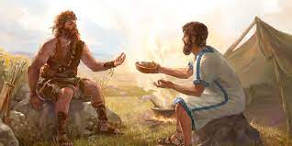
(9) The lives of Jacob and Esau are quite different. (Gen 25:27-28)
(10) Esau was hungry and Jacob was shrewd. (Gen 25:29-34)
(11) Gen 25:31- “And Jacob said, Sell me this day thy birthright.”
(11) Video: 05:00-07:43
(Viewers are cautioned on the inaccurate parts of the video)
(Source: The Bible Stories, Abraham, By Lube Production)
Source: https://www.jw.org/en/library/books/bible-stories-lessons/3/jacob-esau-inheritance/

Slide 6

(12) Spiritual Lesson:
Esau treated serious issues with little regard eg. his birth right.
Are we like Esau? Do we treat the following with little regard:
Our faith
Our conduct as believers
Our relationships with others
Living righteously
(13) We should take our faith, conduct, relationships and righteous living with seriousness.
Source: https://www.slideserve.com/engelbert-nathanial/living-soberly-righteously-godly-in-this-present-world

Slide 7

(14) Spiritual Lesson:
Jacob desired the rights and privileges of the first-born eg. authority over the brethren (Gen 4:7), double portion of inheritance (De 21:17). Jacob took advantage of Esau’s need.
Do we take advantage of the needs of others?
Selling needful products at high profit.
Source: https://www.cetim.ch/covid-19-pandemic-and-human-rights-2/

Slide 8

(15) Spiritual Lesson
When others are in need and you are able to help, what would you do?
Don’t help
Help with payment
Help without payment
Source: https://www.youtube.com/watch?v=UYE2dEyRLHg&list=RDCMUCnobTPLeBxWHurWHq8jzsnA&start_radio=1&rv=UYE2dEyRLHg&t=0

