Slide 1
AdSS4-Abraham’s pre-ordained future
Background: Lot parted from Abraham for the fertile plain of Jordan.
War between 4 kings and 5 kings. (Gen14:1-2) (3)Lot was abducted by the 4 kings. (Gen 14:12)
Abraham and his herdsmen went to rescue Lot. (Gen 14:15- 16)
Another evidence of Abraham’s love for Lot.

Slide 2
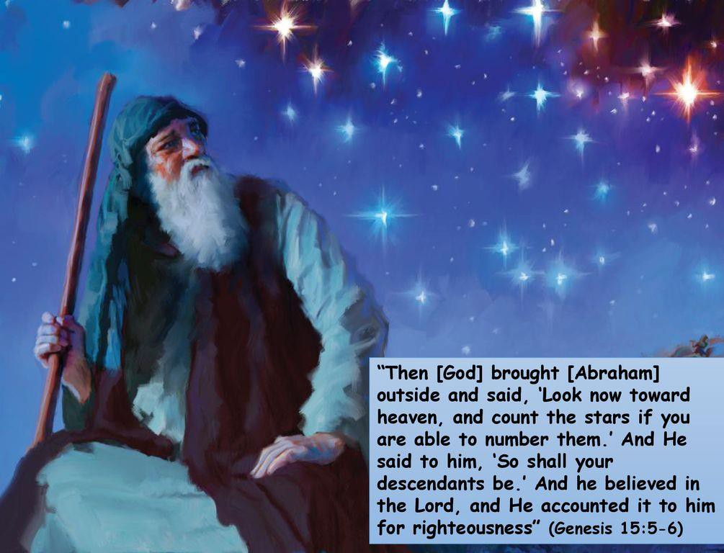
(6) Abraham’s lament to God that he
had no children. (Gen 15:1-2)
God declared that Abraham would have many descendants like the stars in the sky. (Gen 15:5)
Abraham believed in God’s declaration. This belief was credited to Abraham as righteousness. (Gen 15:6)
Source: https://www.google.com/url?sa=i&url=https%3A%2F%2Fslideplayer.com%2Fslide%2F14374723%2F&psig=AOvVaw1jRucJ12EztrX6TUbhYtrx&ust=1639291356364000&source=images&cd=vfe&ved=0CAsQjRxqFwoTCOiE7a- S2_QCFQAAAAAdAAAAABAD

Slide 3

(9) Spiritual Lesson: Today, there are many Jewish people. They are all the descendants of Abraham. God has pre-ordained Abraham’s future descendants. God also pre-ordains our future.
Source: https://www.istockphoto.com/hk/%E7%85%A7%E7%89%87
/group-of-people-waving-the-flag-of-israel-gm524372433-
51578412

Slide 4
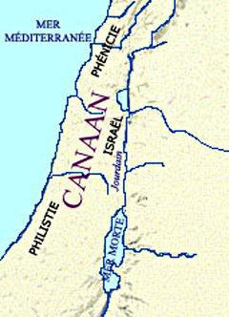
(10) God said that He would give the land of Canaan to Abraham. (Gen 15:7)
Abraham was doubtful. (Gen 15:8)
God made a covenant with Abraham that He would let Abraham and his descendants have the promised land. (Gen 15:18)
Source: http://www.cadtm.org/spip.php?page=imprimer&id_article=8580

Slide 5
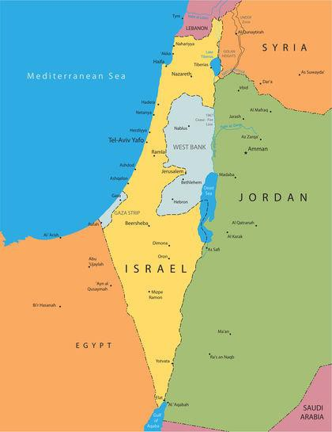
(13) Spiritual Lesson: Today, the Jewish people have the nation Israel, formerly known as Canaan.
c1900 BC
God’s word to Abraham that Canaan would be given to Abraham and his descendants
AD 1948
The establishment of the modern nation of Israel
God had pre-ordained that Canaan would be given to Abraham.
God also pre-ordains our future.
Source: https://www.nationsencyclopedia.com/economies/Asia-and-the-Pacific/Israel.html

Slide 6
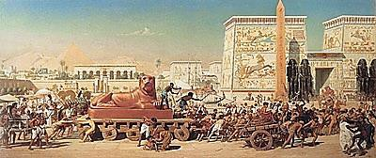
(16) God also disclosed to Abraham that his descendants would be enslaved for 400 years. Thereafter, they would return to Canaan. (Gen 15:13-16)
Slavery in Egypt (Exod 12:40)
Jacob and family dwelt in Egypt
c1900 BC
God’s word to Abraham that his descendants would be enslaved for about 400 years
Moses led the Israelite out of Egypt
Source: https://en.wikipedia.org/wiki/The_Exodus#/media/File:1867_Edward_Poynter_-_Israel_in_Egypt.jpg

Slide 7
(17) Video: 1:51:20-1:54:20
(Viewers are cautioned on the inaccurate parts of the video)
(Source: The Bible Stories, Abraham By Lube Production)

Slide 8

(18) Spiritual Lesson: Our future is ordained by God.
Westminster Confession of Faith, Chapter 3:
“I. God from all eternity did by the most and holy counsel of his own will, freely and unchangeably ordain whatsoever comes to pass;”
“Ordain” means “order”
(Definitions from Oxford Languages )
Source: https://www.faithgateway.com/god-has-a-plan-for-your-life-child-s-life-too/#.YbRXdL1Bwag

Slide 9
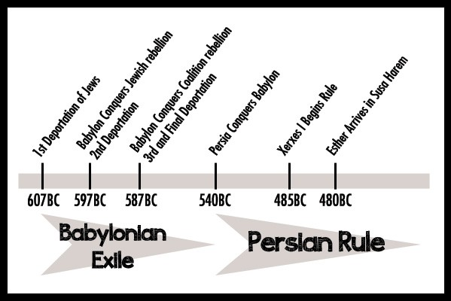
(19)We should feel secure that God has ordained all the events in our life.
Suffering in captivity
– Jeremiah 29:11:
“For I know the thoughts that I think toward you, saith the LORD, thoughts of peace, and not of evil, to give you an expected end.”
538 BC: 1st Jewish people return to Israel
Source: https://redemptionutah.com/esther-timeline-and-map/

Slide 10
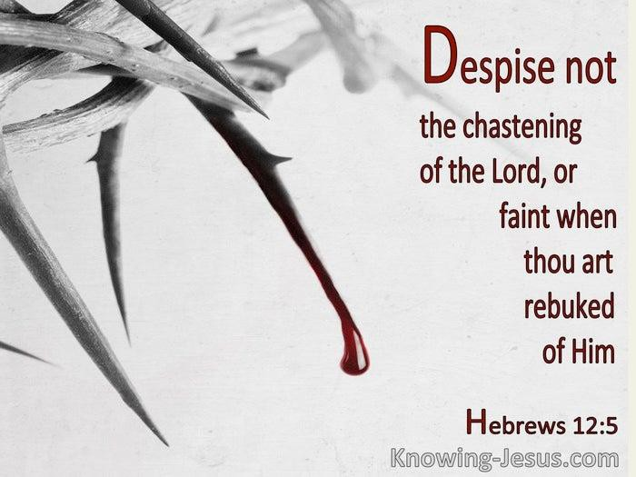
(20) Personal illness:
Psalm 119:
“It is good for me that I have been afflicted; that I might learn thy statutes.”
Psalm 23
Source: https://bible.knowing-jesus.com/topics/Punishment,-By-God

Slide 11

If you know that God has ordained all events in your life from eternity past, you should be motivated to live a holy life.
Suffering and chastisement are part of believers’ sanctification process to be holy.
Source: http://www.spirit-empowered.com/2016/09/

Slide 12
(23) Reflection:
Are you living a holy life now – thought, speech, action?
Which aspects of your life are not right in God’s sight?
What will you do to make that aspect right before God?

