Slide 1
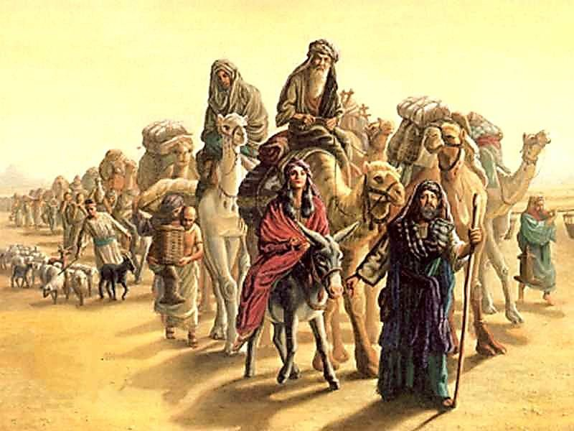
AdSS3-Abraham and Lot parted ways
Background
In Egypt, Pharoah took Sarah for his wife.
Abraham had lied to Pharoah that Sarah was his sister.
God intervened and restored Sarah back to Abraham.
Abraham became wealthy (Gen 13:2)
Source: https://scripturescript.files.wordpress.com/2014/02/abraham1.jpg

Slide 2

Abraham called to God. (Gen 13:4)
Spiritual Lesson: Give thanks to God when He has blessed you.
Source: https://www.biblestudytools.com/bible-study/topical-studies/prayers-of-thanks-and-gratitude-to-god.html

Slide 3
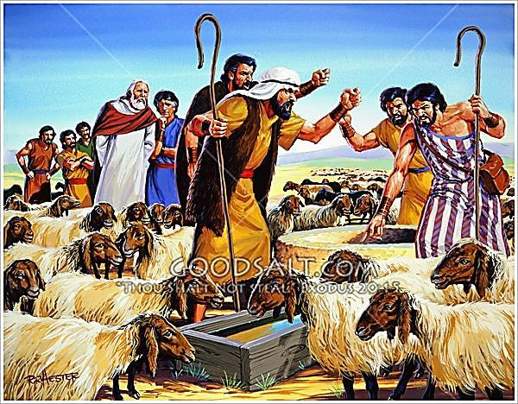
(5) Dispute between Abraham’s herdsmen and Lot’s herdsmen.
Both Abraham and Lot had many livestock.
The land was not able to accommodate both of them together and their livestock.
Gen: 13:6-7
Source: https://www.goodsalt.com/details/lfwas1294.html

Slide 4
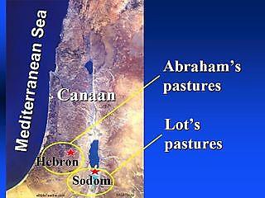
(6) Abraham gave in to Lot.
Abraham appealed to Lot that there be no quarrels.
Abraham gave Lot the option for the best land.
Lot took the plain of Jordan
Gen 13:8-11
(7) Video: 01:27:30-01:30:58
(Viewers are cautioned on the inaccurate parts of the video)
(Source: The Bible Stories, Abraham By Lube Production)
Sea of Galilee
Dead Sea
Source: https://rkwetzel.wordpress.com/2016/06/02/day-4-jordan-river-valley-part-8/

Slide 5
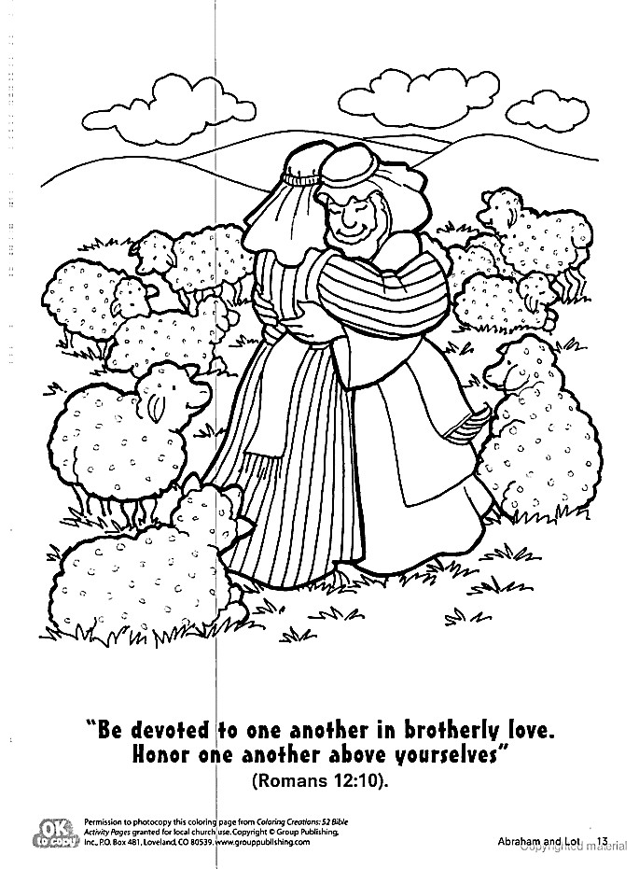
(8) Abraham’s love
Love for Lot
Love for the people of Sodom
Source: https://www.pinterest.com/pin/414683078167698990/

Slide 6

(9)Lot’s choice – the plain of Jordan
Material considerations (well-watered plain, like the garden of the Lord, like the land of Egypt). (Gen:13:10)
It was also near Sodom where profitable trade could be carried out with the city-dwellers.
Subsequently, due to Sodom’s influence, Lot became carnal. (Gen 19:8)
Source: https://www.weforum.org/agenda/2 019/10/wealth-household- economie/

Slide 7

(9) Spiritual Lesson: Christian love
Abraham has love for Lot and the common people.
As Christians, we should also show love for others:
Family and relatives who are junior to us.
At workplace, our colleagues.
Neighbours, friends, workers and cleaners etc.
Source: https://i.swncdn.com/media/400w/cms/CW/family/friends- people/67049-gettyimages-1094812112-rawpixel.400w.tn.jpg

Slide 8

Spiritual Lesson:
Do not be like Lot in making decisions based on material consideration only.
Spiritual consideration is most important when making decisions.
Source: https://www.njlifehacks.com/materialism-happiness/

Slide 9
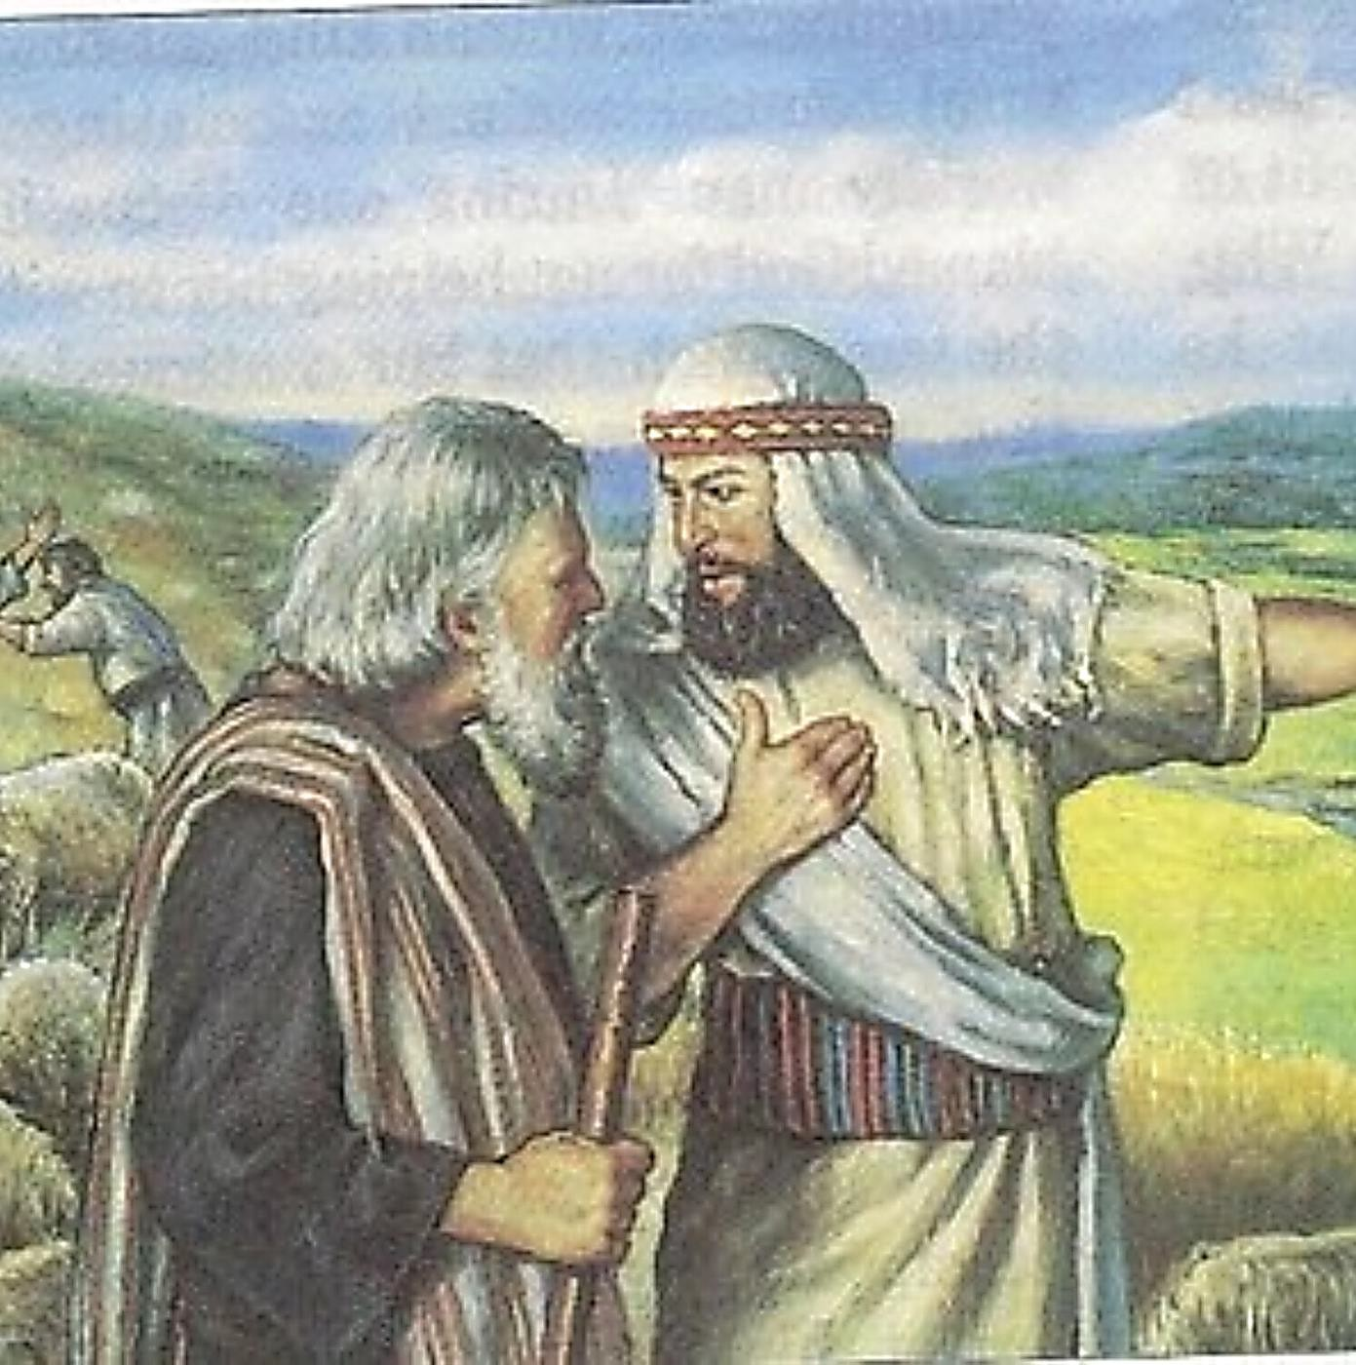
(10) Reflection:
Are you a Lot or an Abraham?
If you are a Lot, what would you do to change?
Source: https://pod.co/lamp-and-light-bible-study/genesis-15-24-abraham-and-lot

