Slide 1
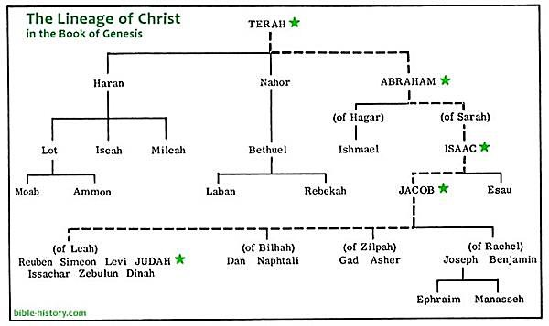
Spiritual Lessons from the Life of Abraham
Abraham was a native of Ur (in modern day Iraq) in Mesopotamia.
Born c1996 BC. Died c1815 BC.
Source: https://www.myolivetree.com/the-family-tree-
of-the-bible-from-abraham-to-jesus-to-you/

Slide 2
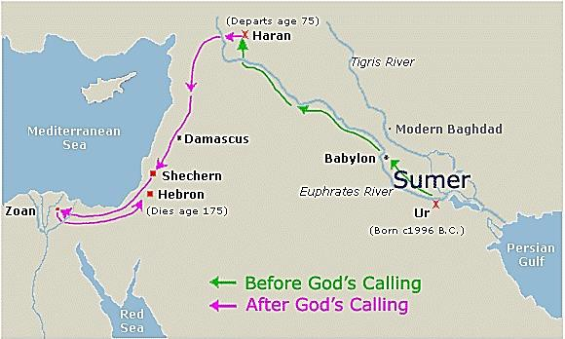
Gen 11:26
Gen 12:1 – Abraham’s calling Gen 12:5 – From Haran to Gen 12:6 Canaan
Modern day Turkey
Modern day Israel
Modern day Iraq
Source: https://kzlam36.files.wordpress.com/2013/01/abrahams-journey-map.gif

Slide 3
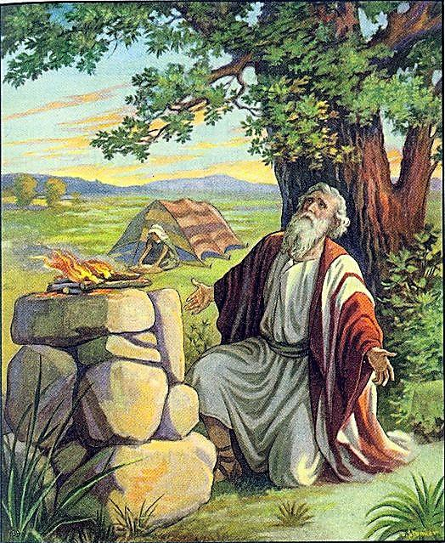
(3) Terah had 3 sons - Abram, Nahor, Haran (Gen 11:26)
(4) Terah, Abram, Lot and Sarai went to Haran (Gen 11:31)
(5) Abraham’s calling (Gen12:1)
  Abraham heeded the calling
  How do we know God’s
will for us in our life?
Source: https://childrenschurch.files.wordpress.com/2014/01/scan0002.jpg

Slide 4
Abraham departed Haran for Canaan (Gen12:5)
(video29:51 –35:33)
(Viewers are cautioned on the inaccurate parts of the video)
  Sadness of leaving members of the family in Haran
  Journeying on foot
  Exposed to weather and hardship of travelling
  Travelled a distance of about 640km (twice the distance from Singapore to Kuala Lumpur, Malaysia) from Haran to Shechem (a few months journey on foot)

Slide 5

Questions:
  If it was God’s calling to go to the Promised Land, why did God not
provide instant transportation to Canaan?
Even though it was God’s calling for them to go to Canaan, they would have to go through the usual trials of travelling and circumstances in life.
Application:
  Even if we are living in God’s will, we will encounter trials in our lives.
Source: https://www.linkedin.com/pulse/doing-gods- keeps-us-different-realm-peace-joy- monickaraj-arul

Slide 6
The Canaanites were in the land. (Gen 12:6)
The Lord appeared to Abraham and encouraged Abraham. (Gen 12:7)
There were hostility and famine in Canaan. (Gen 12:10)
(video 43:30 – video 49:16)
(Viewers are cautioned on the inaccurate parts of the video)

Slide 7
Abraham went to Egypt (Gen 12:10)
(video 53:04-55:06)
(Viewers are cautioned on the inaccurate parts of the video)
The trials of Abraham:
  The difficult journey from Haran to Canaan
  Meeting hostile Canaanites in Canaan
  Famine in Canaan
  Difficult journey from Canaan to Egypt

Slide 8
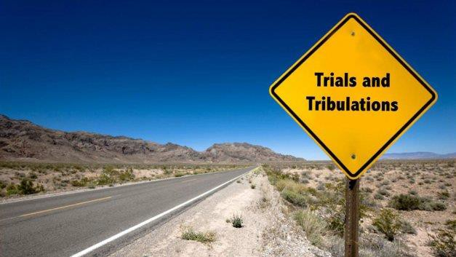
Application:
As Christians, we heed God’s will, but there will be trials.
God doesn’t give us a life of absolute bliss.
In the midst of trials, God is there to guide and protect us.
Reflection:
Are there trials which you are facing?
Are you in a situation of trial within God’s will or outside God’s will?
How to be faithful to God despite the trials?
Source: https://askgramps.org/trials-others/

