Slide 1
EVERYDAY COMMISSION
PROCESS – BUILDING AND EQUIPPING
BUILDING A CHRIST-LIKE COMMUNITY
THAT CARES AND SHARES.

Slide 2
Establishing a Foundation for Growth And Community
THE RIGHT QUESTION:
What is preventing my church from growing?
Growth comes from being healthy.
Health comes from balance in ministry.

Slide 3
DRIVE
…..By Tradition
…..By personalities
…..By finances
…..By buildings
…..By programs
…..By events (calendar)
…..By the unchurched

Slide 4
Ask Two Questions:
What are we to be?
What are we to do?
(Pro 19:21) There are many devices in a man's heart; nevertheless the counsel of the LORD, that shall stand.

Slide 5
The Great Commandment
“Love the Lord Your God with all your heart…soul…
…and mind. This is the first and greatest
commandment.
And the second is like it: Love Your Neighbour as yourself. All the Law and Prophets hang on these two commandments”
Matthew 22:36-40

Slide 6
The Great Commission
“Go and make Disciples of all nations, Baptizing them in the name of the Father and of the Son and of the Holy Spirit, and Teaching them to do everything I have commanded you.”
Matthew 28:19-20

Slide 7
Five Instructions
1. “Love God with all your heart” – Worship
2. “Love your Neighbour as yourself” – Ministry
3. “Go….make Disciples” – Evangelism
4. “Baptizing them” – Fellowship
5. “Teaching them to do” – Equipping

Slide 8
The church exists to:
1. Celebrate God’s presence (Worship)
2. Communicate God’s Word (Evangelism)
3. Incorporate God’s family (Fellowship)
4. Educate God’s people (Equipping)
5. Demonstrate God’s love (Ministry)

Slide 9
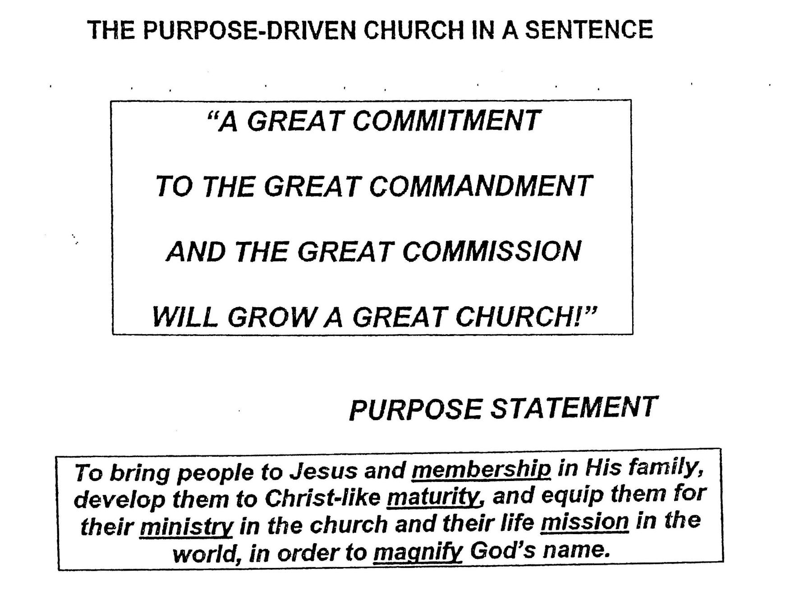

Slide 11
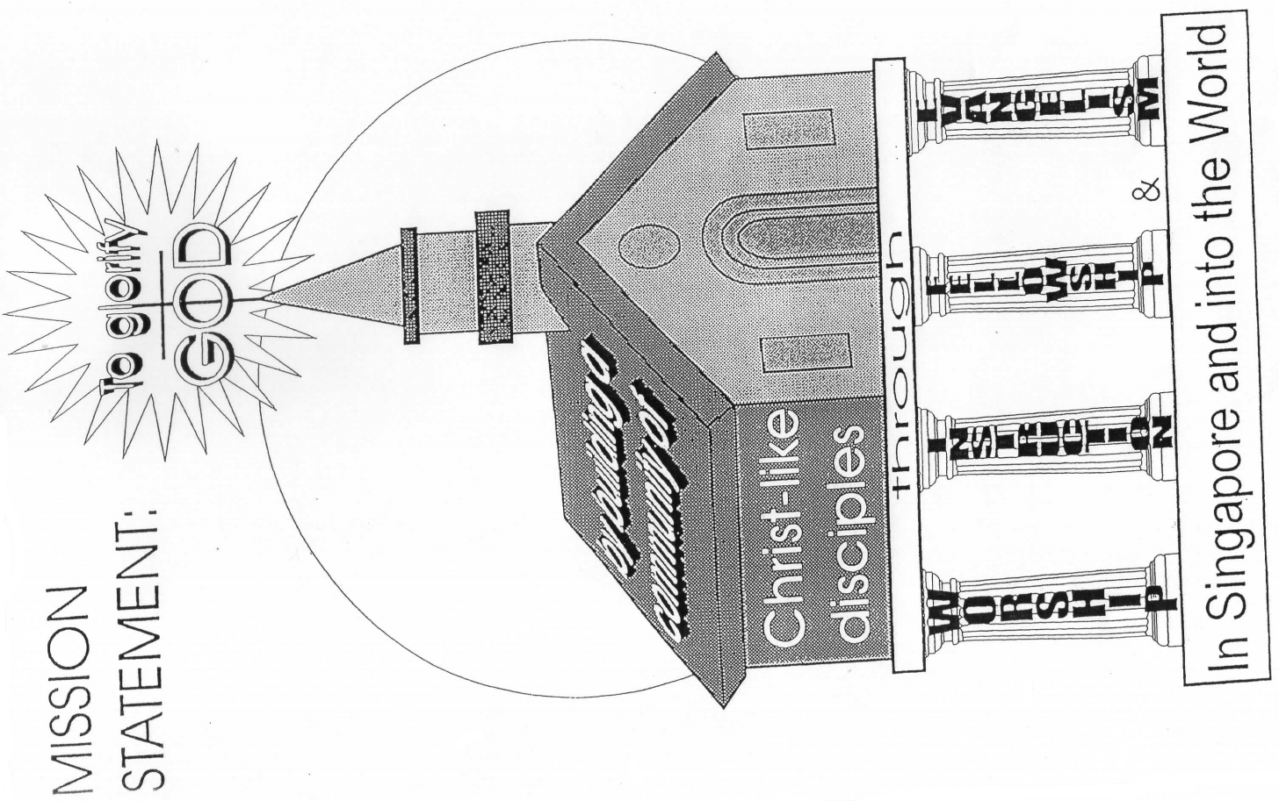

Slide 12
Communicating your Purposes
5 ways to Communicate Vision
1. Slogan
2. Symbols
3. Scriptures
4. Stories
5. Specifics

Slide 13
Some of the ways to do so:
Every Membership Class
Annual message
Monthly emphasis
Print it in the bulletin
Articles and brochures
Monthly Pastor’s coffee
Sermons

Slide 14
Applying your purposes
You must apply the purposes to every area of your church’s life.
The key to application is balance.

Slide 15
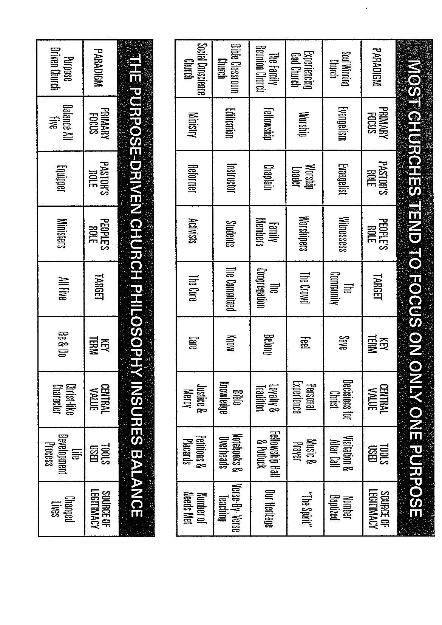

Slide 16
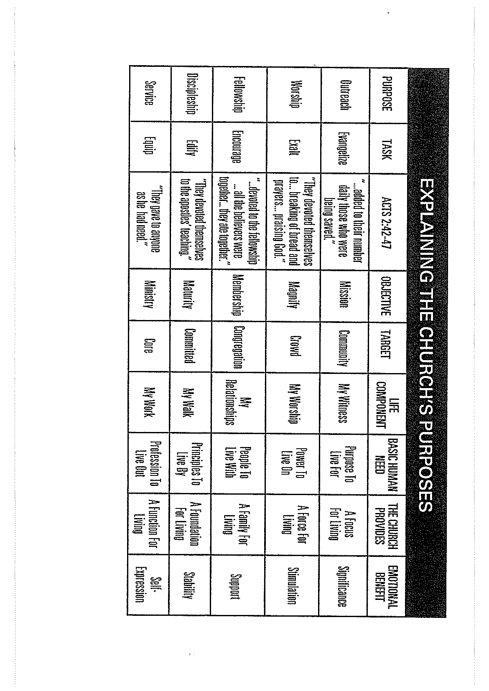

Slide 17
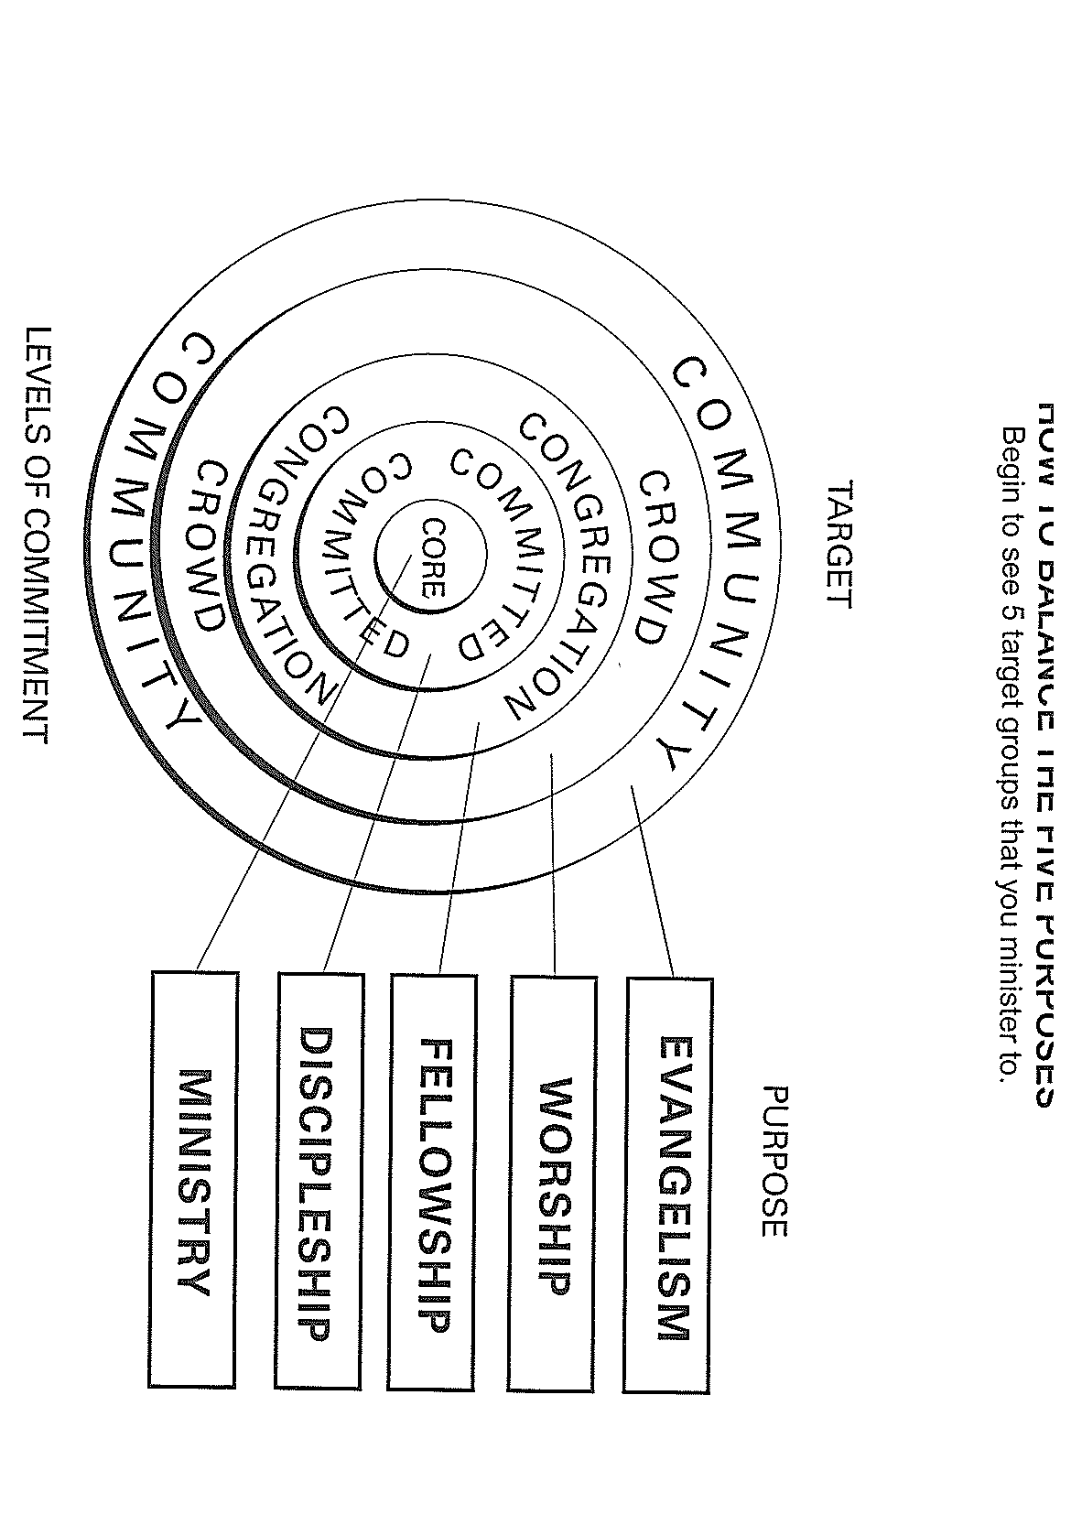

Slide 18
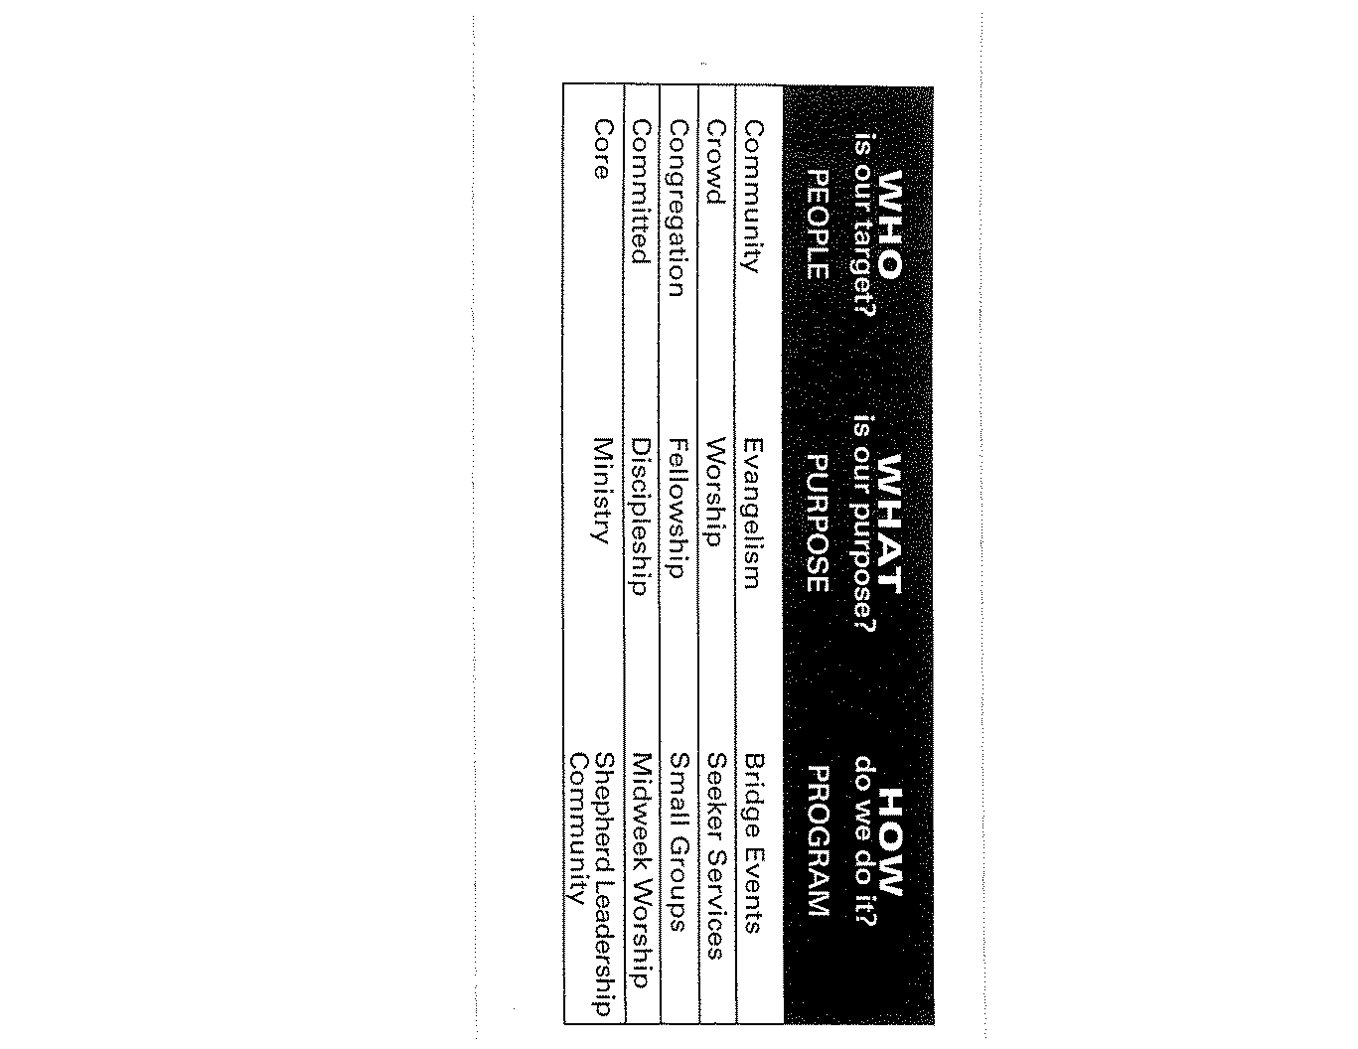

Slide 19
Ten ways to be Purpose-Driven
1. Assimilate New Members
on Purposes.
2. Program around Purposes.
3. Educate people on Purposes.
4. Form Small groups on Purposes.
5. Add staff on Purposes.

Slide 20
Ten ways to be Purpose-Driven
6. Structure by Purposes
7. Preach on Purposes.
8. Budget on Purposes.
Calendar on Purposes.
Evaluate on Purposes.

Slide 21
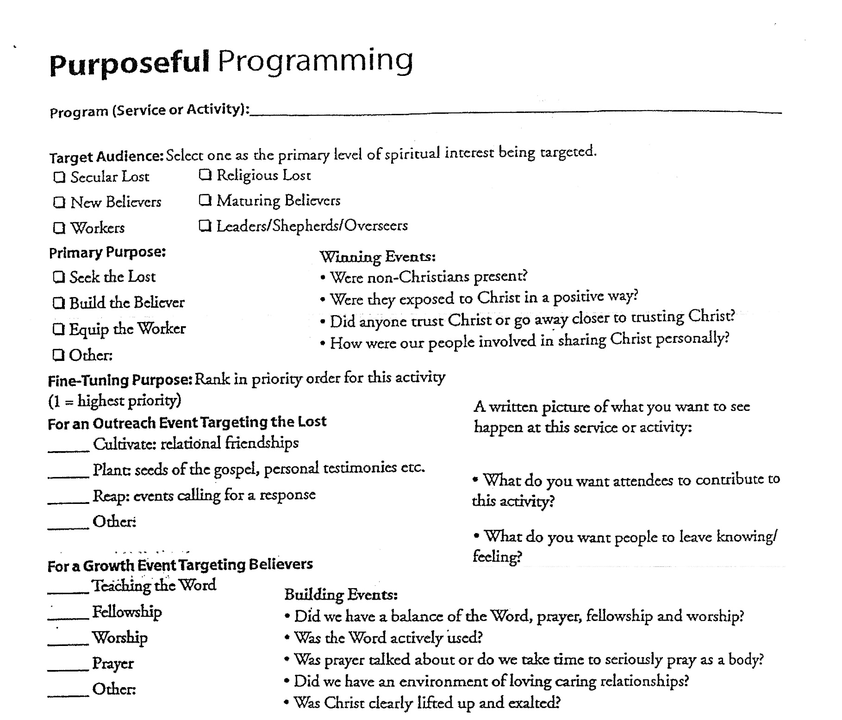

Slide 22



Slide 23
Attracting a
Crowd to Worship
(Matt. 9:36)

Slide 24
Twelve convictions
1. Only believers can truly worship God (John 4:34).
2. You don’t need a building to worship God
(Acts 17:24).
3. There is no correct “style” of worship (John 4:24).
4. Unbelievers can watch believers worship
(Acts 5:13).
5. Worship is a powerful witness (Acts 2:6,7).

Slide 25
Twelve convictions
6. God expects us to be sensitive to the fears, hang ups, and needs (Col. 4:5).
7. A worship service does not have to be shallow to be evangelistic but understandable (1 Cor. 10:32).
8. The needs of believers and unbelievers often overlap (origin, purpose, destiny, relationships).

Slide 26
Twelve convictions
9. It is best to specialize your services according to their purpose and targets.
10. A service geared toward unbelievers is meant to supplement personal evangelism, not replace it.
11. There is no standard way to design an evangelistic worship service (changed lives attract).

Slide 27
12. It takes unselfish, mature believers to offer an evangelistic worship service (Issues of control, comfort and care)
Four universal quests:
a. Longing to know and to be known
b. Longing to know who I am
c. Longing to know why I am here
d. Longing to know God

Slide 28
How to design an evangelistic
worship service
1. Plan it with your target in mind.
2. Make it as easy as possible to attend.
3. Improve the pace and flow of your service.
4. Focus on making visitors feel comfortable. (First 12 min. before & after)
5. Station warm and encouraging ushers.

Slide 29
Remember three keys:
Don’t expect people to act like believers until they are.
If you want to minister the unchurched,
you can’t be shocked by them (1 Cor. 9:22).
Jesus showed acceptance of people without approval of everything they did.

Slide 30
Brighten up Your Environment
Lighting: Is it bright enough?
Temperature: Too warm or cold?
Seating arrangements
Space: Not too much or little
Decorations: best and cheapest are plants
Nurseries: Clean and safe?
Restrooms: Clean and odor-free!

Slide 31
1. Preach with target and purpose in mind.
2. Always offer an opportunity to receive Christ and expect people to respond.
3. Continue to evaluate and improve.
(Visitor’s card & staff evaluation)

Slide 32
Match your Music with those
You want to reach. (Psalm 100)
Preview all your music (doctrinal).
Speed up the tempo!
Edit archaic terms & make them understandable.
Find right balance of amount (Psalm 40:3).
Use more performed music
Use music for the heart, not the “art”
Encourage your members to write new songs (Ps. 96:1).

Slide 33
Turning Attenders
into Members
(Family Eph. 2:19)

Slide 34
Communicate value of membership of love and acceptance (John 13:35)
Believing (Acts 16:31)
Belonging (Eph. 2:19)
Becoming (Rom. 8:29)

Slide 35
Develop plans to assimilate
Five questions Prospective Members ask:
1. Do I fit here? (acceptance)
2. Does anyone want to know me? (friendship)
3. Am I needed? (value)
4. What is the advantage of joining? (benefit)
5. What is required of the members? (expectations)

Slide 36
Benefits of Membership
1. Identifies me as a believer (Eph. 2:19)
2. Provides spiritual family (Gal. 6:1-2)
3. Places me under spiritual protection of godly leaders (Heb. 13:17)
4. Gives me accountability I need to grow (Eph. 5:21)
5. Gives me a place to discover and use my gifts in ministry (1 Cor. 12:4-27)

Slide 37
Establish a required
Membership class
The manner in which people join your church
will determine their effectiveness as members
for years to come.
Commitment is important with a covenant.

Slide 39
Create opportunities to build
relationship.
Retreats
Fellowship
Name Tags
Relational Activities

Slide 40
Encourage every member to join a Small group.
Keep on communicating (Prov. 27:23).
Make them feel special (Certificates & cards).

Slide 41
Developing Mature Members (2 Cor. 13:9)

Slide 42
Growth Begins with Commitment
1. We become what we are committed to.
2. Every church is known by what it is
committed to (1 Thess. 1:8)
3. You must ask for commitment or you
won’t get it!

Slide 43
Growth Begins with Commitment
4. The greater the commitment you ask for,
the greater the response (Luke 14:33).
5. If your church doesn’t ask for commitment,
others will.
6. People want to be committed to something
that gives their lives meaning.
7. Build on commitment, rather than towards it.

Slide 44
Growth is a Process
1. Decide on Priorities (to know and be).
2. Design a Plan with growth steps.
3. Develop your Program with options.

Slide 45
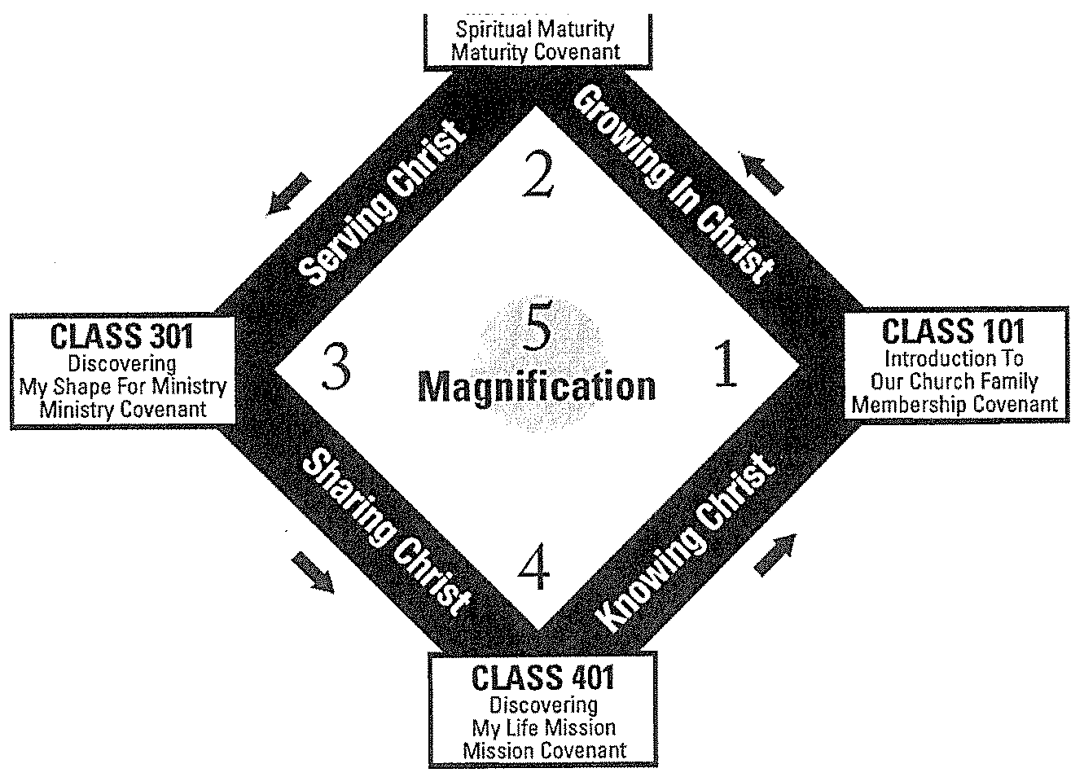

Slide 46
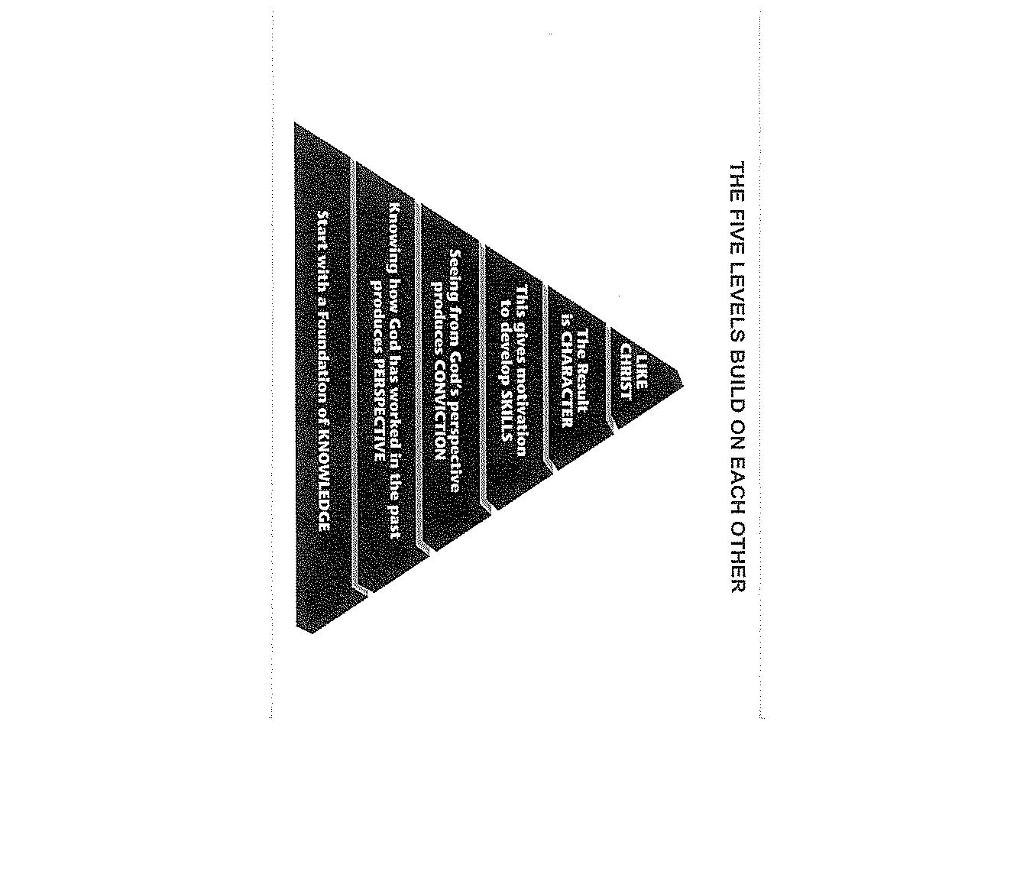

Slide 47


Slide 48
Growth involves developing
spiritual habits.
3 Most important Spiritual Habits
1. A daily time with God (Mark 1:35)
2. A weekly tithe to God (1 Cor. 16:2)
3. A Committed team for God (Heb. 10:25)

Slide 49
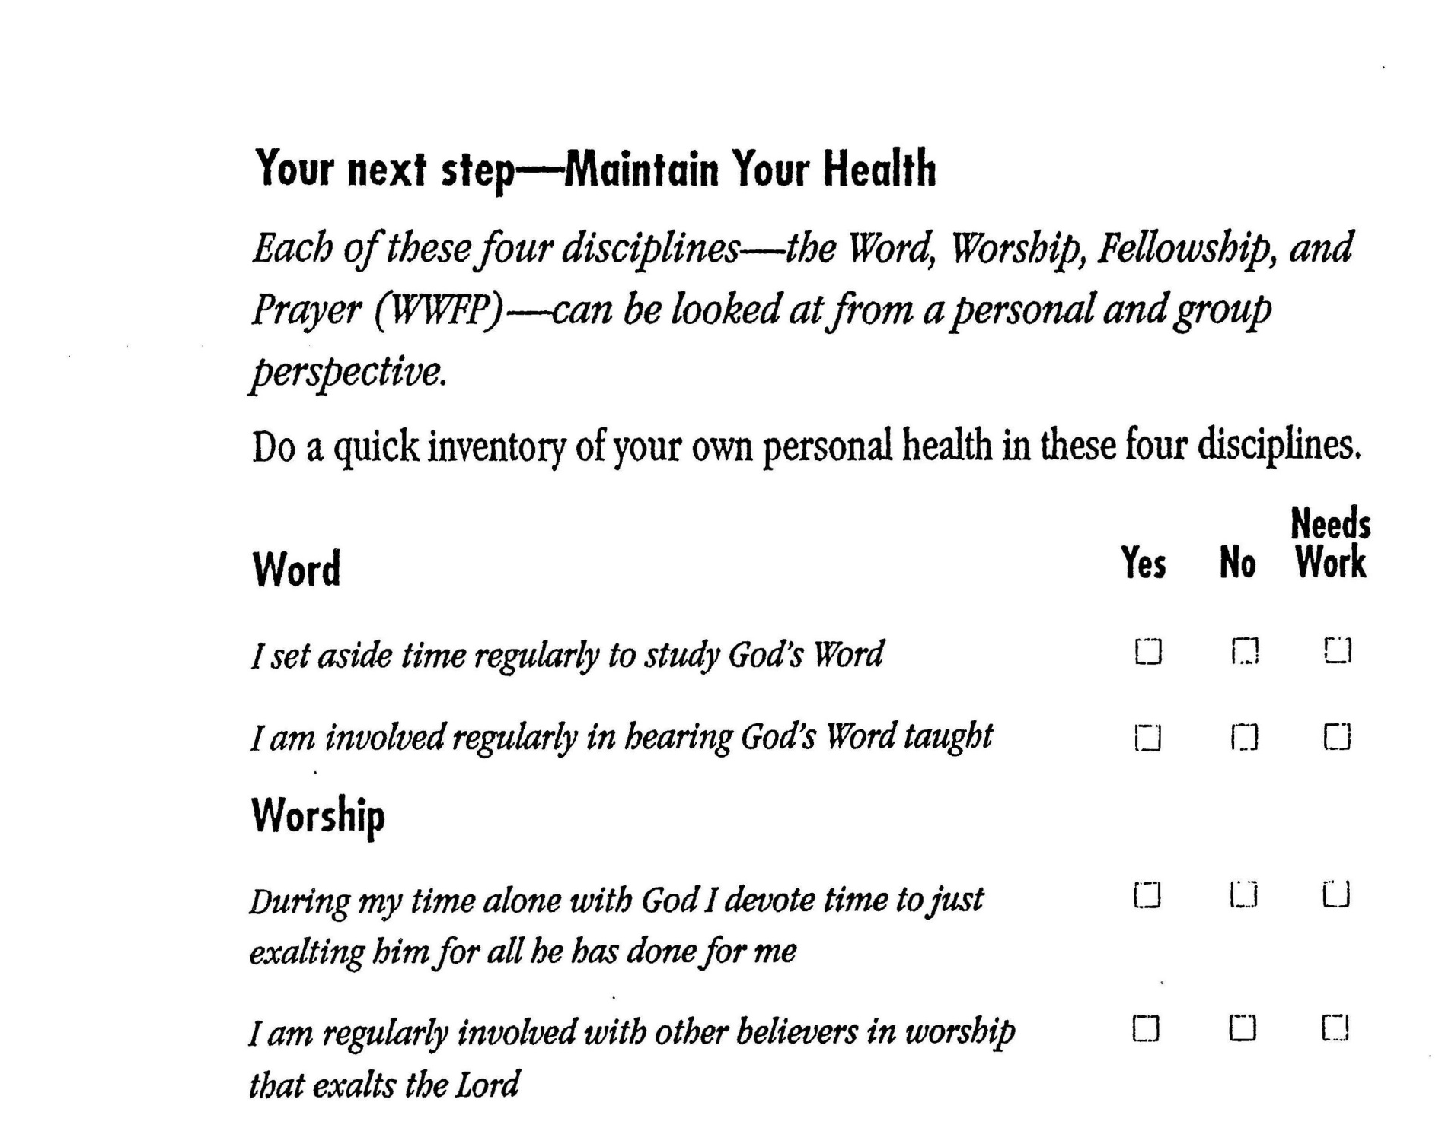

Slide 50
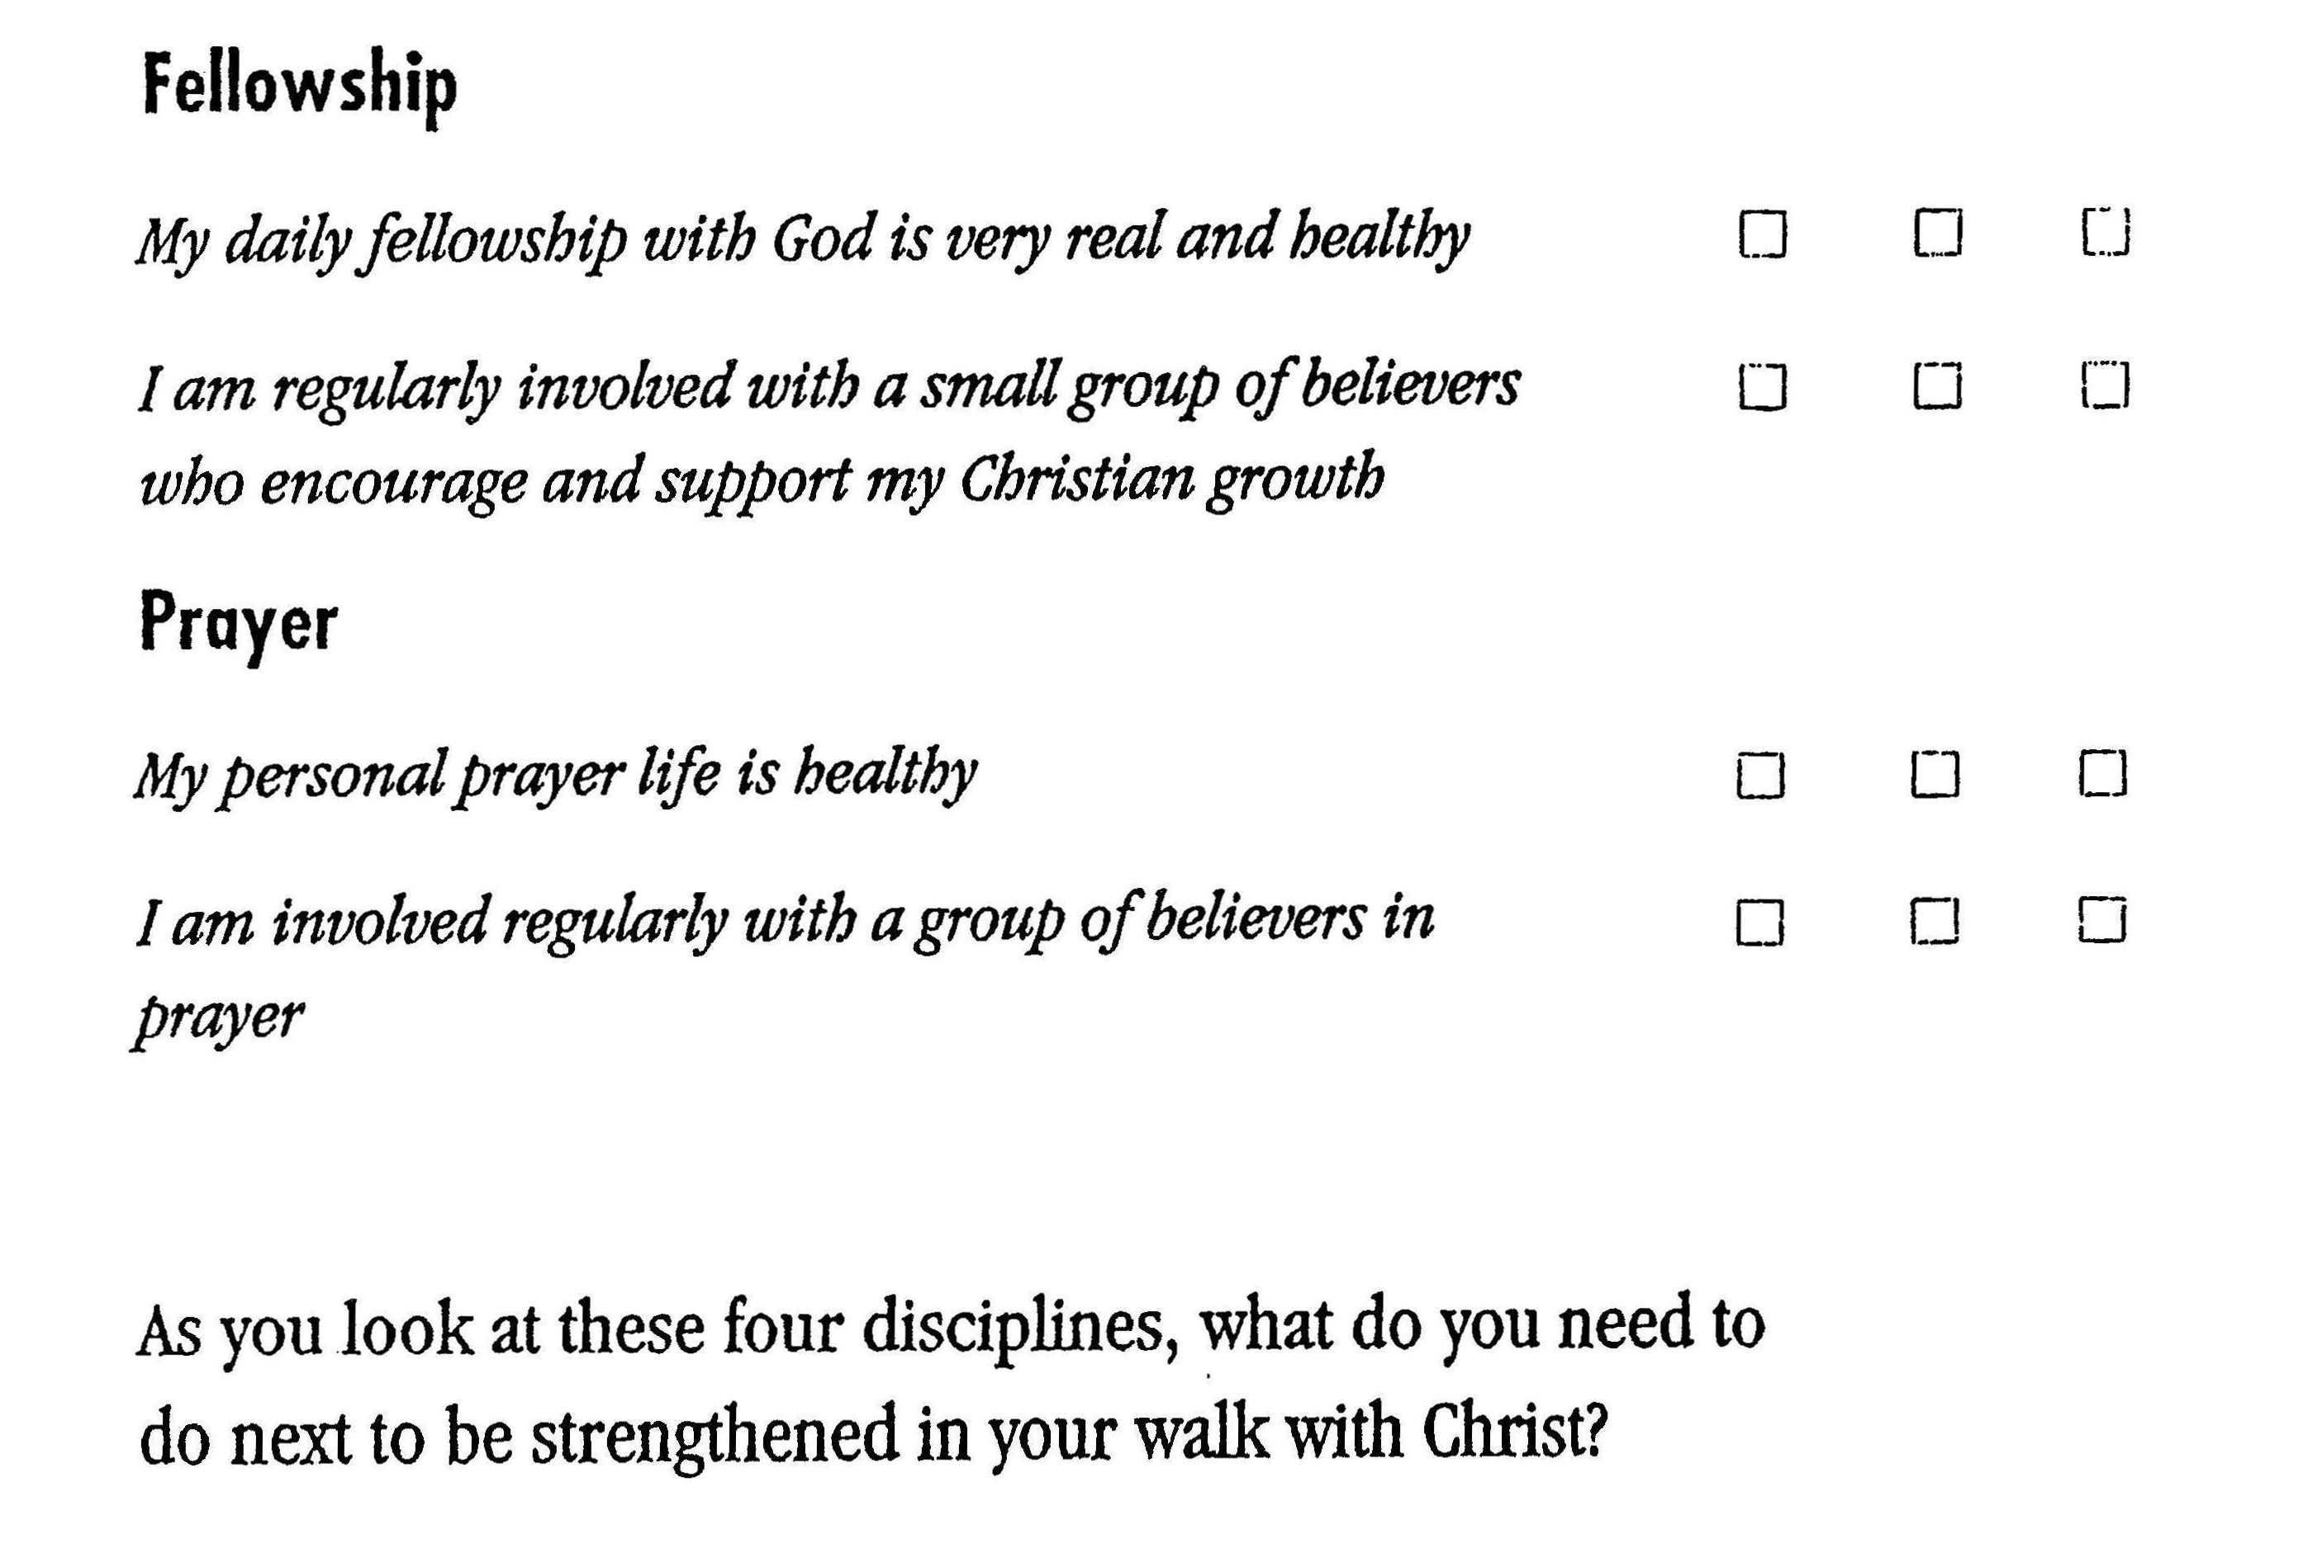

Slide 51
Growth is stimulated by
Relationships

Slide 52

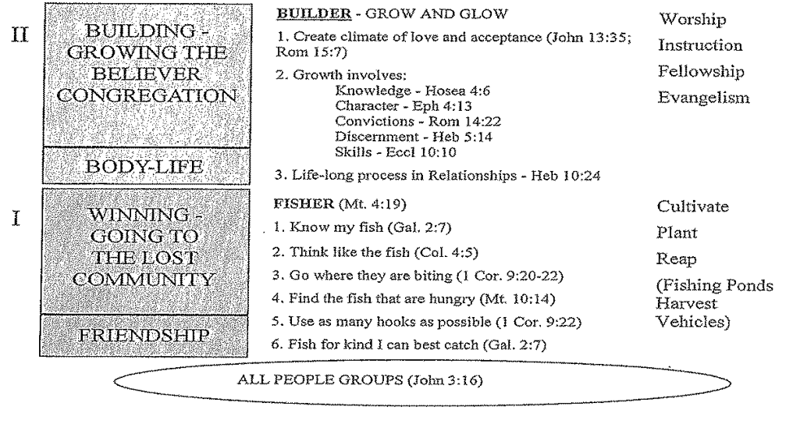

Slide 53
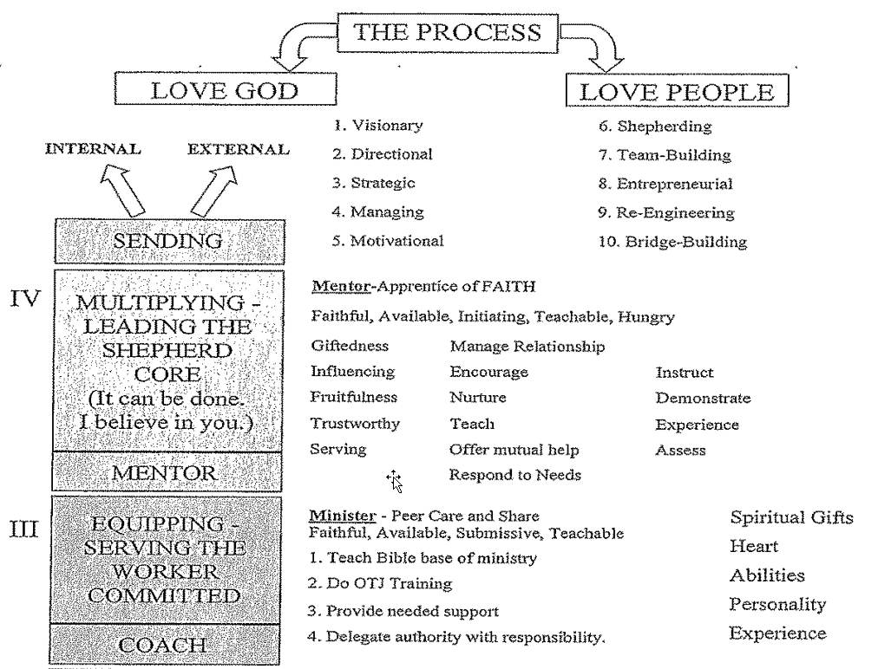

Slide 54
Purpose Driven Small Groups (Acts 20:20)

Slide 55
GROWING LARGER AND SMALLER
Grow warmer through fellowship
Grow deeper through equipping.
Grow stronger through worship.
Grow broader through ministry.
Grow larger through evangelism.
SMALL HOME GROUPS -
WHERE EVERONE KNOWS MY NAME

Slide 56
(Act 2:42-47) And they continued stedfastly in the apostles' doctrine and fellowship, and in breaking of bread, and in prayers.
And fear came upon every soul: and many wonders and signs were done by the apostles.
And all that believed were together, and had all things common;
And sold their possessions and goods, and parted them to all men, as every man had need.

Slide 57
And they, continuing daily with one accord in the temple, and breaking bread from house to house, did eat their meat with gladness and singleness of heart,
Praising God, and having favour with all the people. And the Lord added to the church daily such as should be saved.

Slide 58
What did the Home Groups Do?
Growing Spiritually and deeper
Fellowshipped with encouragement
Worshipped with exaltation
Ministered with practical service
Witnessing to fulfil mission

Slide 59
Grouping People by Affinity
Common Culture
Common Location
Common Calendar
Common Concern
Common Ministry Project
Common Crisis-Support

Slide 60
The Benefits
1. I’ll feel like a real part of Church family.
2. I’ll understand God’s Word better.
3. I’ll receive the accountability I need
to Grow.
4. I’ll be able to handle stress better with support.
5. It’s a safe place to develop Gifts.
6. It is a natural relaxed way to share Faith.

Slide 61
Small Groups and Sunday
School
It does not matter which one you use as
long as you get people into a heart to heart relationship with God’s Word and one another!

Slide 62
Small Groups and Sunday
School
Both Small Groups an Sunday School are
Leader’s factory.
The Secret: Rotate the Leadership in
every Group!

Slide 63
Small Groups and Sunday
School
Advantages of Sunday School:
1. Convenient time
2. Convenient Place

Slide 64
Small Groups and Sunday
School
Disadvantages of Sunday School:
1. You must Start or Stop on time
2. It uses up facility space
3. Some people will not bring Unbelievers

Slide 65
Advantages of Home Groups
1. You can have longer time to achieve purposes
2. It has a more intimate, relaxed atmosphere
3. They are infinitely Expandable
4. They are geographically Unlimited
5. They are good Stewardship

Slide 66
What you will need:
1. Options in Schedule
2. Options in Study Topics
3. Options in Location
4. A constant supply of Leaders

Slide 67
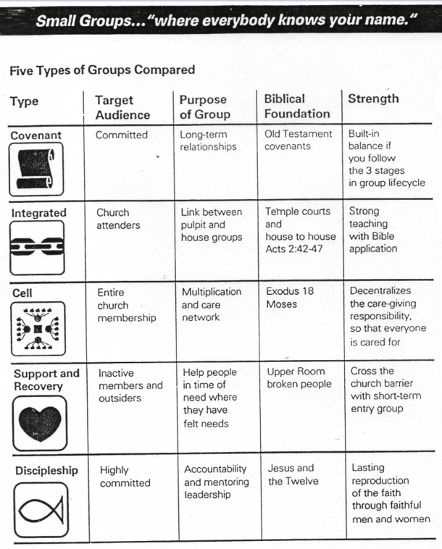

Slide 68
6 Foundational Convictions
1. Every member deserves Personal care
2. The best place to provide it is through small groups
3. Every group deserves a Shepherd who
Loves them.

Slide 69
6 Foundational Convictions
4. Every group needs to fulfil all 5 purposes.
5. Every purpose needs a Champion in every small group.
6. The best way to raise up quality leaders is through apprentices.

Slide 70
Empowering Your Core For Ministry

Slide 71
Teach the Biblical base for
Lay Ministry (Rom. 12:1-8)
Every believer is a minister
Every ministry is important
We are dependent and inter-dependent
Ministry is the expression of my S.H.A.P.E.

Slide 72
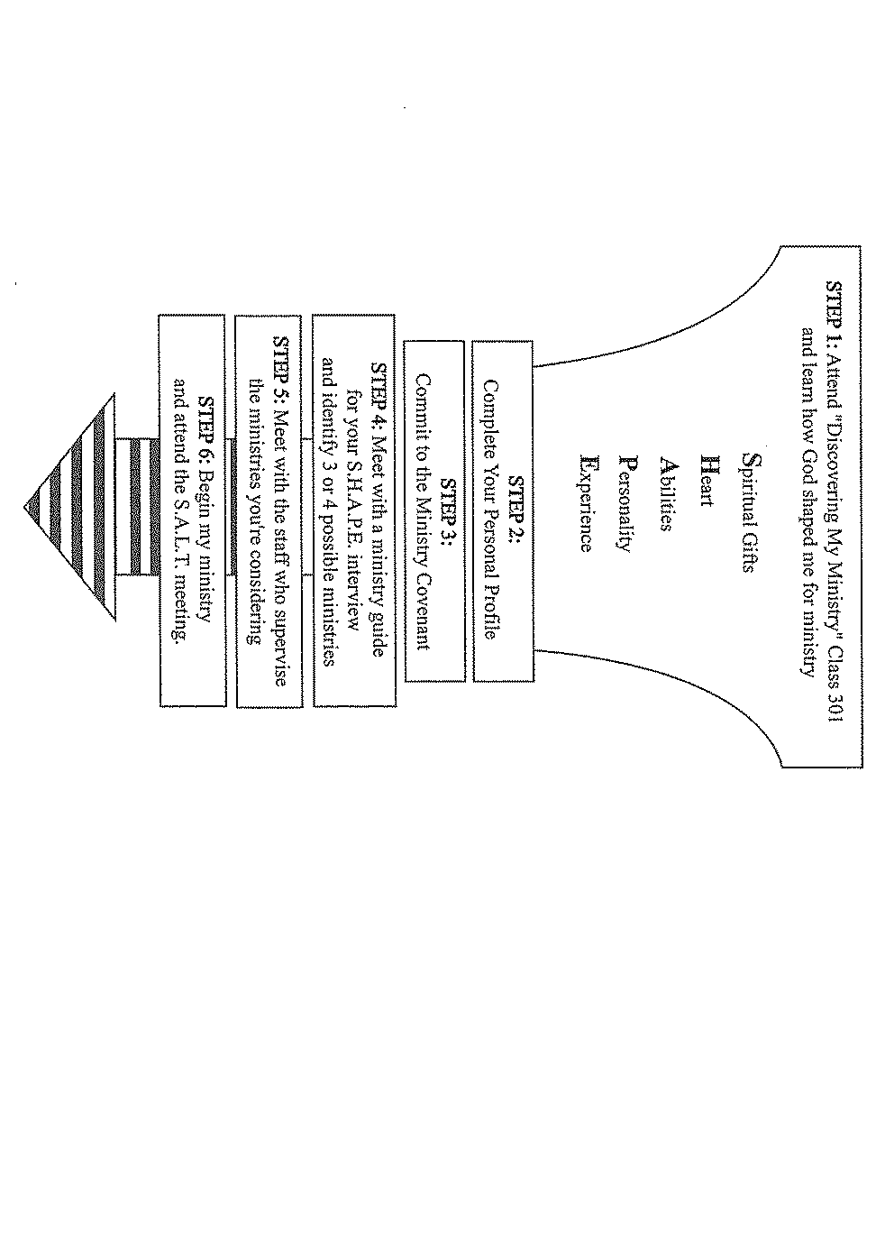

Slide 74
Maximize ministry and minimize Maintenance.
Provide On the job training.
Never start a ministry without a leader.
Provide the support needed.

Slide 75
Delegate authority with
Responsibility and best interest.
B – Believe; E – Empower;
S – Support; T – Trust
The key to Motivation: Ownership
Give them a Challenge
Give them Control
Give them Credit

Slide 76
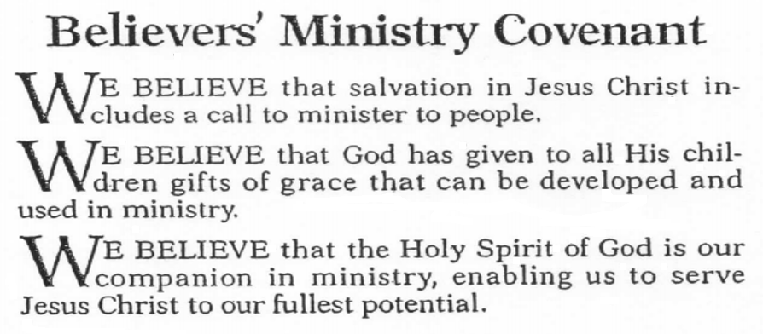

Slide 77
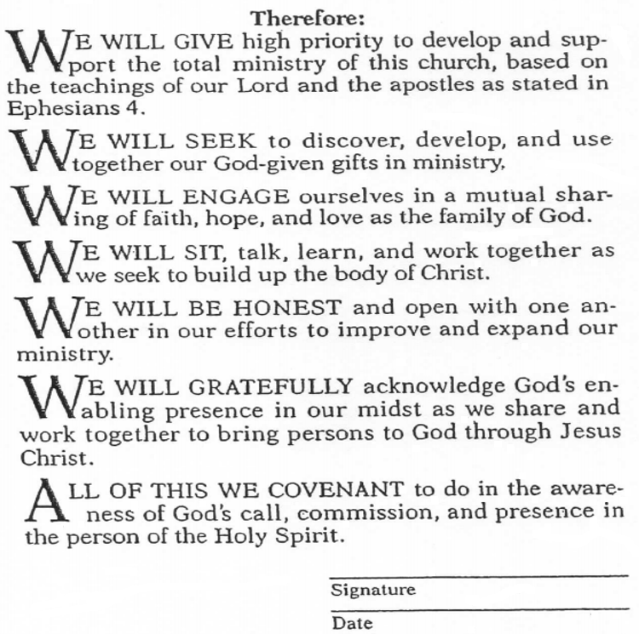

Slide 78
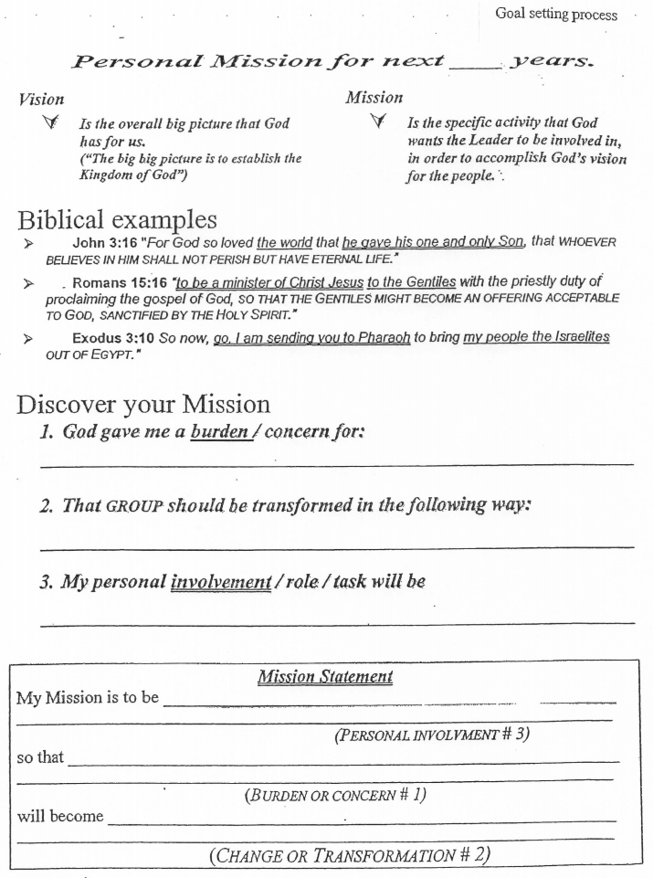

Slide 79
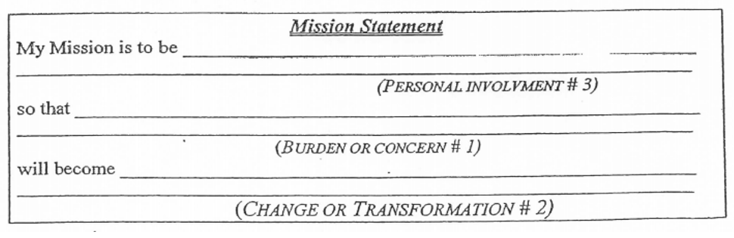

Slide 80
MY MISSION STATEMENT
Burden: National Leaders
Be transformed: that they be Christ-like community with integrity and skills (Psalm 78:72)
My task: to equip and mentor them
My Mission is to be equipping and mentoring National leaders so that they be a Christ-like community with integrity and skills (Psalm 78:72).

Slide 81
ASSIGNMENTS
1. Using the theme of the five purposes and the three given purpose statements, please write your own purpose statement for your church.
Using the format for your personal mission, please write down your own personal mission for the next five years.
3. Please assess the advantages and disadvantages of home small groups.

Slide 82

BUILD & EQUIP
WHAT ONE LESSON HAVE I LEARNT?
WHAT WILL ONE PRAYER BE?

Slide 83

  Email: gohsengfong@hotmail.com
  WhatsApp: +65-98207783
  Website: www.FaithAtWorkFellowship.org

